Slide 1
Responsive Reading:
Exodus 27:1 – 27:4
Notes:
<number>
<number>
<number>

Slide 2
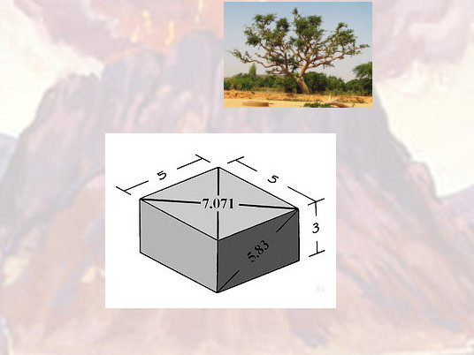
And thou shalt make an altar of shittim wood, ﬁve cubits long, and ﬁve cubits broad;

Slide 3
the altar shall be foursquare: and the height thereof shall be three cubits.

Slide 4
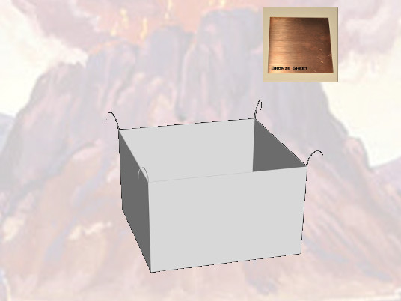
And thou shalt make the horns of it upon the four corners thereof:

Slide 5
his horns shall be of the same: and thou shalt overlay it with brass.

Slide 6
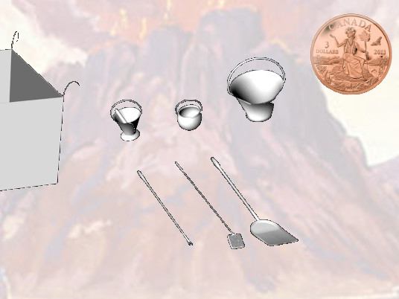
And thou shalt make his pans to receive his ashes, and his shovels, and his basons,

Slide 7
and his ﬂeshhooks, and his ﬁrepans:

Slide 8
all the vessels thereof thou shalt make of brass.

Slide 9
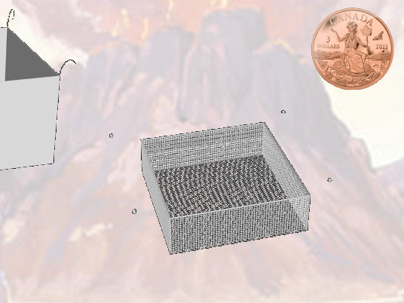
And thou shalt make for it a grate of network of brass;

Slide 10
and upon the net shalt thou make four brasen rings in the four corners thereof.

Slide 11
Responsive Reading:
Read white verses
Platform Elder
Exodus 27:5 – 27:12
Notes:
<number>
<number>
<number>

Slide 12
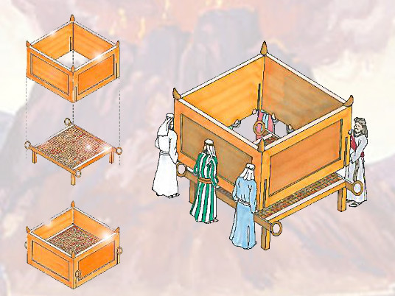
And thou shalt put it under the compass of the altar beneath,

Slide 13
that the net may be even to the midst of the altar

Slide 14
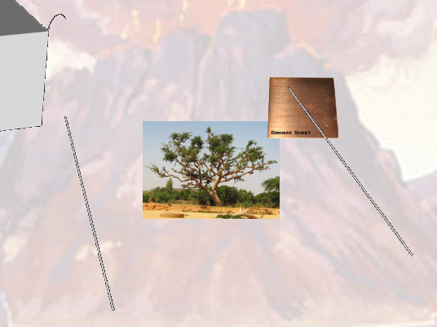
And thou shalt make staves for the altar, staves of shittim wood,

Slide 15
and overlay them with brass.

Slide 16
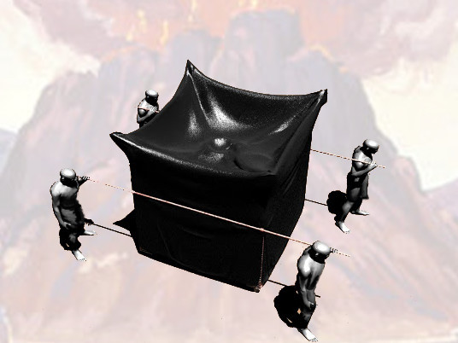
And the staves shall be put into the rings,

Slide 17
and the staves shall be upon the two sides of the altar, to bear it.

Slide 18
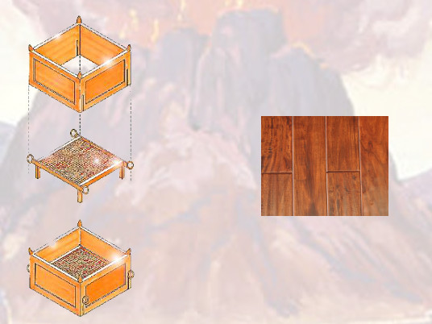
Hollow with boards shalt thou make it:

Slide 19
as it was shewed thee in the mount, so shall they make it

Slide 20
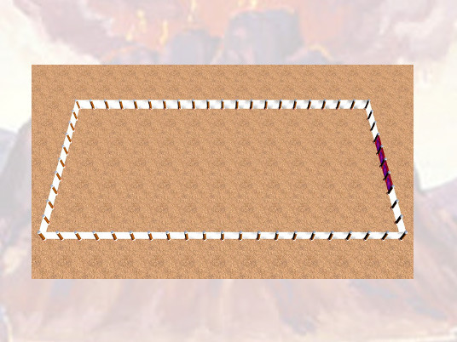
And thou shalt make the court of the tabernacle:

Slide 21
for the south side southward there shall be hangings for the court

Slide 22
of ﬁne twined linen of an hundred cubits long for one side:

Slide 23
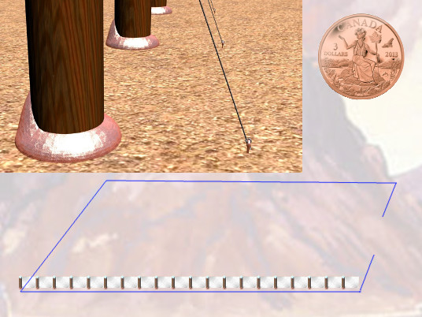
And the twenty pillars thereof and their twenty sockets shall be of brass;

Slide 24
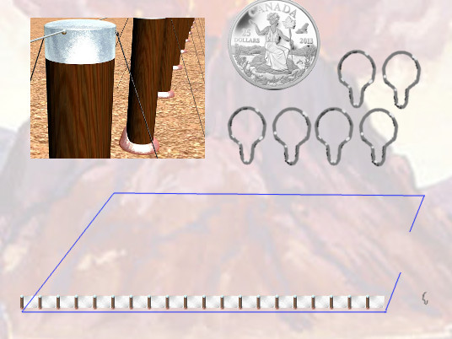
the hooks of the pillars and their ﬁllets shall be of silver.

Slide 25
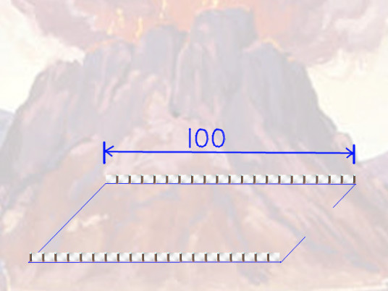
And likewise for the north side in length there shall be hangings of an hundred cubits long,

Slide 26
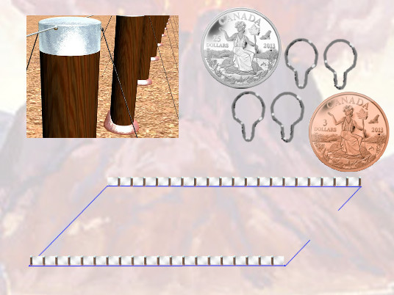
and his twenty pillars and their twenty sockets of brass; the hooks of the pillars and their ﬁllets of silver.

Slide 27
the hooks of the pillars and their ﬁllets of silver.

Slide 28
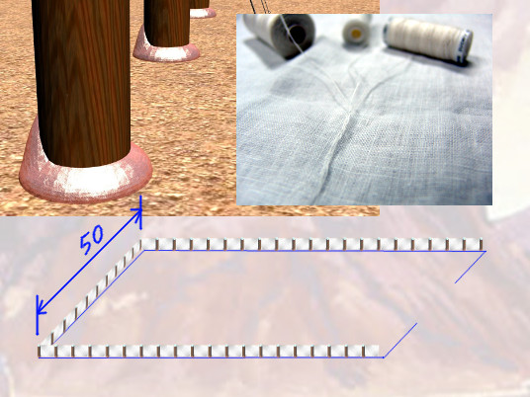
And for the breadth of the court on the west side shall be hangings of ﬁfty cubits:

Slide 29
their pillars ten, and their sockets ten.

Slide 30
Responsive Reading:
Exodus 27:13 – 27:20
Notes:
<number>
<number>
<number>

Slide 31
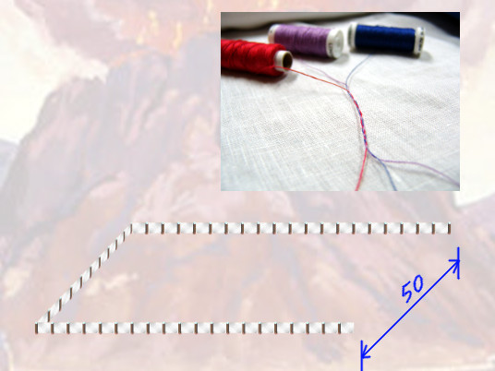
And the breadth of the court on the east side eastward shall be ﬁfty cubits.

Slide 32
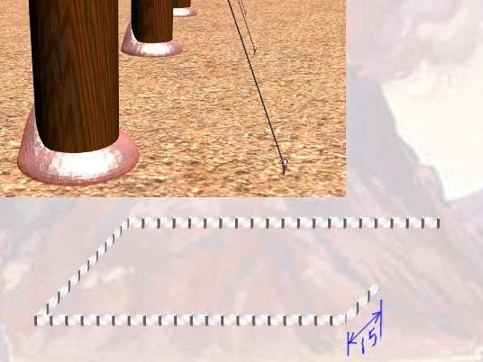
The hangings of one side of the gate shall be ﬁfteen cubits:

Slide 33
their pillars three, and their sockets three.

Slide 34
And on the other side shall be hangings ﬁfteen cubits:

Slide 35
their pillars three, and their sockets three

Slide 36
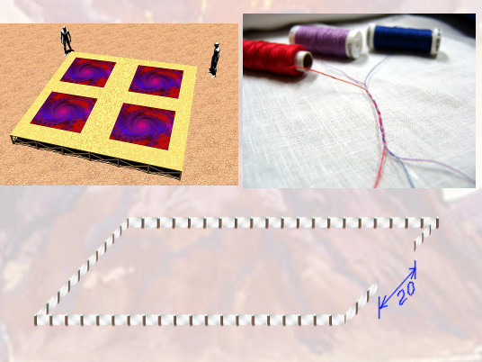
And for the gate of the court shall be an hanging of twenty cubits,

Slide 37
of blue, and purple, and scarlet, and ﬁne twined linen, wrought with needlework:

Slide 38
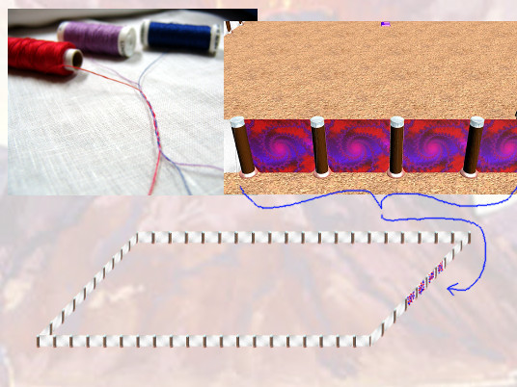
and their pillars shall be four, and their sockets four.

Slide 39
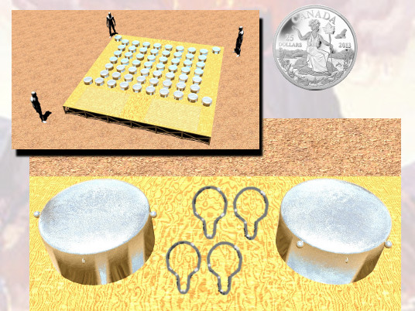
All the pillars round about the court shall be ﬁlleted with silver; their hooks shall be of silver,

Slide 40
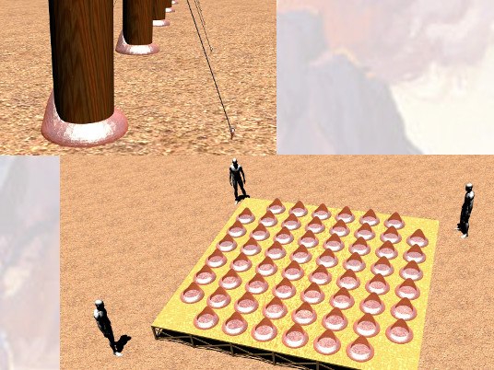
and their sockets of brass

Slide 41
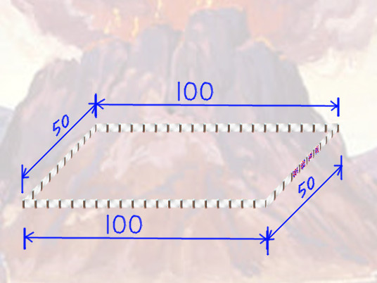
The length of the court shall be an hundred cubits, and the breadth ﬁfty every where,

Slide 42
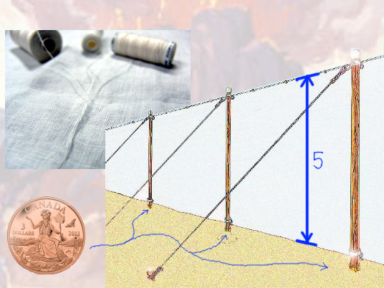
and the height ﬁve cubits of ﬁne twined linen, and their sockets of brass.

Slide 43
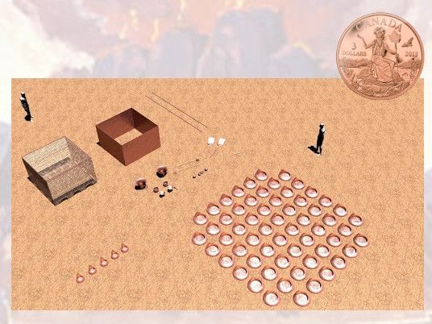
All the vessels of the tabernacle in all the service thereof,

Slide 44
and all the pins thereof, and all the pins of the court, shall be of brass.

Slide 45
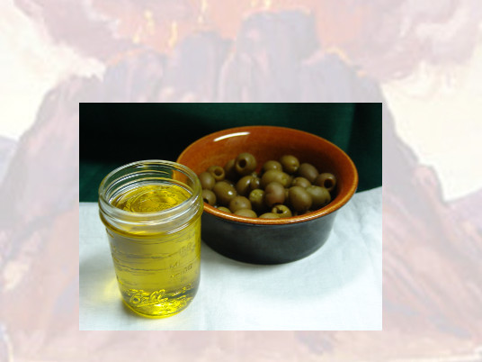
And thou shalt command the children of Israel,

Slide 46
that they bring thee pure oil olive beaten for the light, to cause the lamp to burn always.

Slide 47
Responsive Reading:
Exodus 27:21
Notes:
<number>
<number>
<number>

Slide 48
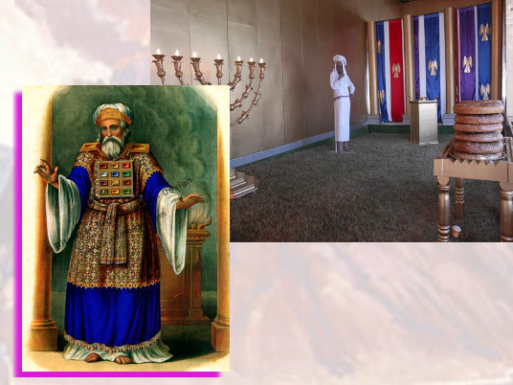
In the tabernacle of the congregation without the vail,

Slide 49
which is before the testimony, Aaron and his sons shall order it from evening to morning

Slide 50
before the LORD: it shall be a statute for ever unto their generations

Slide 51
on the behalf of the children of Israel.

