Slide 1
Responsive Reading:
Exodus 29:1 – 29:4
Notes:
<number>
<number>
<number>

Slide 2
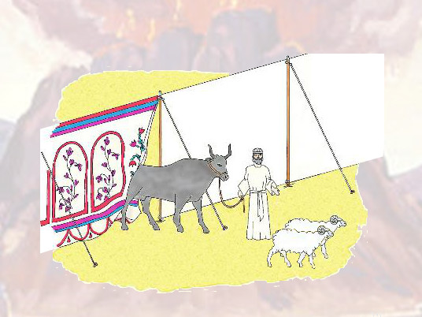
And this is the thing that thou shalt do unto them to hallow them,

Slide 3
to minister unto me in the priests oﬃce:

Slide 4
Take one young bullock, and two rams without blemish

Slide 5
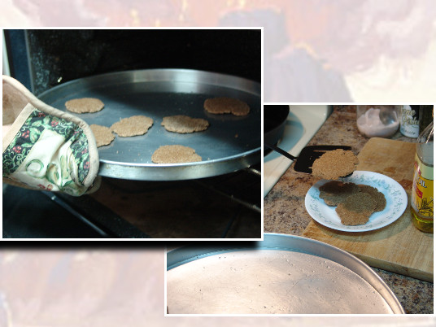
And unleavened bread,

Slide 6
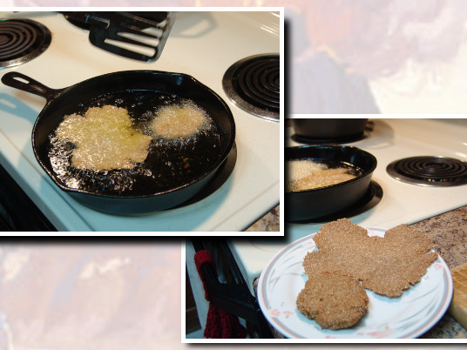
and cakes unleavened tempered with oil,

Slide 7
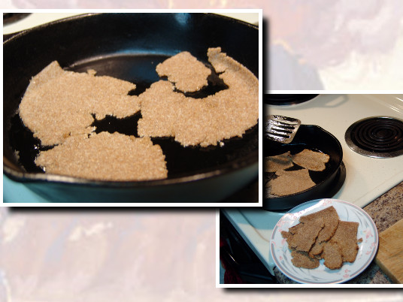
and wafers unleavened anointed with oil:

Slide 8
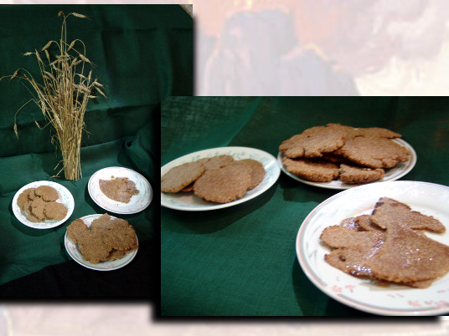
of wheaten ﬂour shalt thou make them.

Slide 9
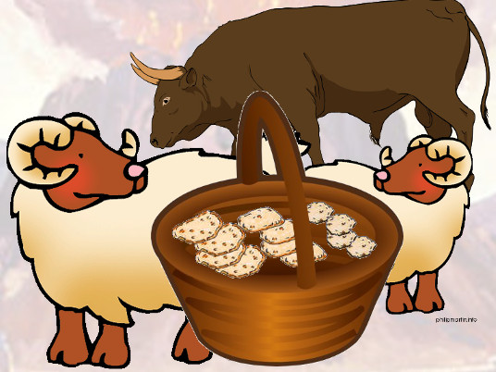
And thou shalt put them into one basket, and bring them in the basket,

Slide 10
with the bullock and the two rams.

Slide 11
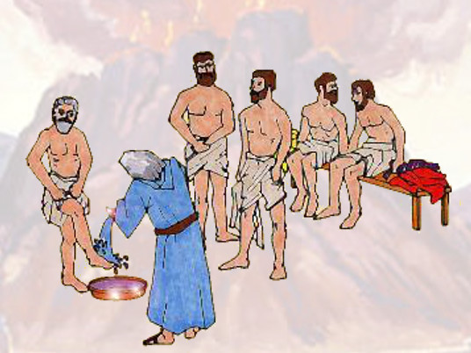
And Aaron and his sons thou shalt bring unto the door

Slide 12
of the tabernacle of the congregation, and shalt wash them with water.

Slide 13
Responsive Reading:
Exodus 29:5 – 29:12
Notes:
<number>
<number>
<number>

Slide 14
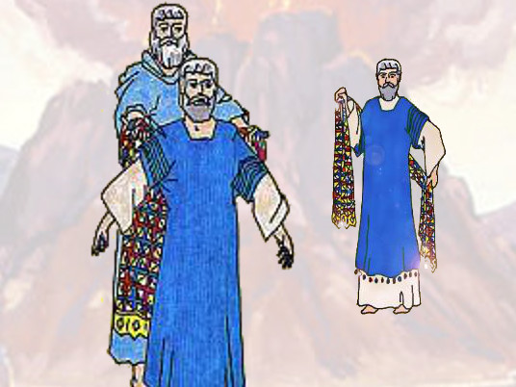
And thou shalt take the garments, and put upon Aaron the coat, and the robe of the ephod,

Slide 15
and the ephod, and the breastplate, and gird him with the curious girdle of the ephod:

Slide 16
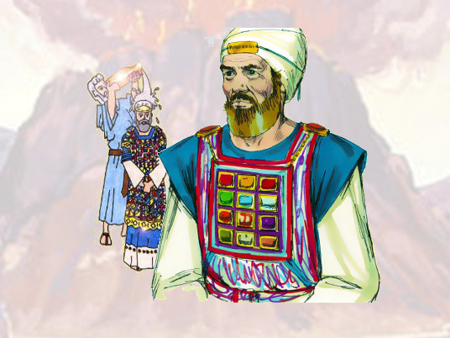
And thou shalt put the mitre upon his head, and put the holy crown upon the mitre.

Slide 17
Then shalt thou take the anointing oil, and pour it upon his head, and anoint him.

Slide 18
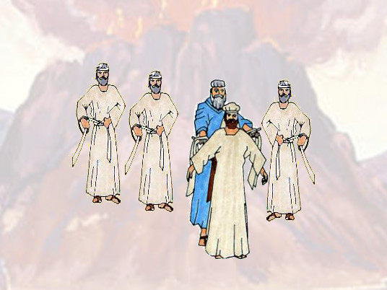
And thou shalt bring his sons, and put coats upon them

Slide 19
And thou shalt gird them with girdles, Aaron and his sons, and put the bonnets on them:

Slide 20
and the priests oﬃce shall be theirs for a perpetual statute:

Slide 21
and thou shalt consecrate Aaron and his sons.

Slide 22
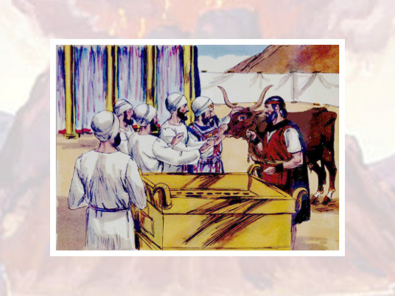
And thou shalt cause a bullock to be brought before the tabernacle of the congregation:

Slide 23
and Aaron and his sons shall put their hands upon the head of the bullock.

Slide 24
And thou shalt kill the bullock before the LORD,

Slide 25
by the door of the tabernacle of the congregation.

Slide 26
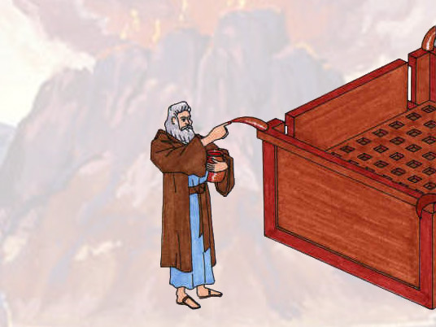
And thou shalt take of the blood of the bullock,

Slide 27
and put it upon the horns of the altar with thy ﬁnger,

Slide 28
and pour all the blood beside the bottom of the altar.

Slide 29
Responsive Reading:
Exodus 29:13 – 29:20
Notes:
<number>
<number>
<number>

Slide 30
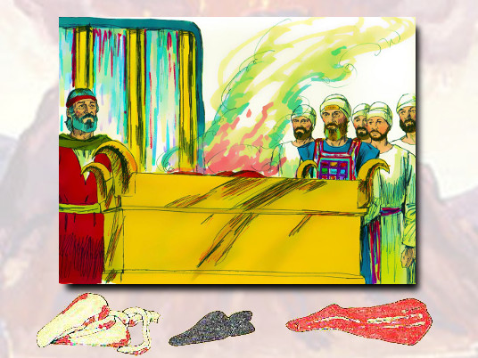
And thou shalt take all the fat that covereth the inwards, and the caul that is above the liver,

Slide 31
and the two kidneys, and the fat that is upon them, and burn them upon the altar.

Slide 32
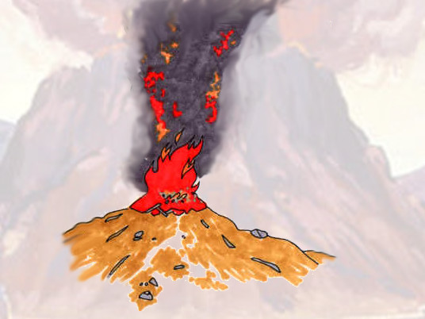
But the ﬂesh of the bullock, and his skin, and his dung,

Slide 33
shalt thou burn with ﬁre without the camp: it is a sin oﬀering.

Slide 34
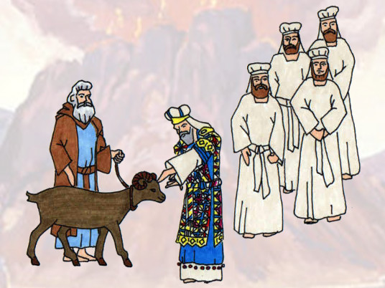
Thou shalt also take one ram;

Slide 35
and Aaron and his sons shall put their hands upon the head of the ram.

Slide 36
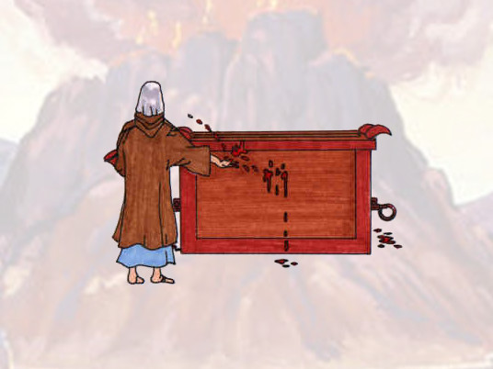
And thou shalt slay the ram, and thou shalt take his blood, and sprinkle it round about upon the altar.

Slide 37
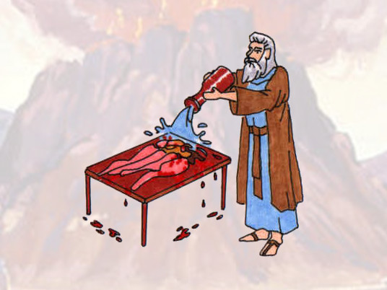
And thou shalt cut the ram in pieces, and wash the inwards of him,

Slide 38
and his legs, and put them unto his pieces, and unto his head.

Slide 39
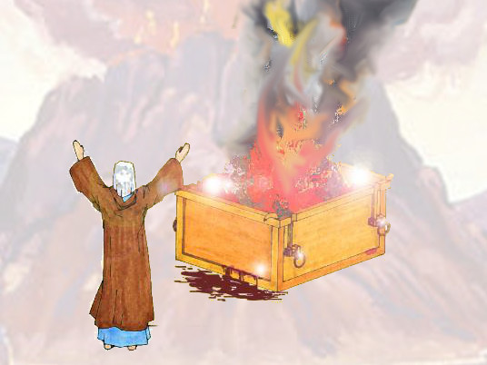
And thou shalt burn the whole ram upon the altar: it is a burnt oﬀering unto the LORD:

Slide 40
it is a sweet savour, an oﬀering made by ﬁre unto the LORD.

Slide 41
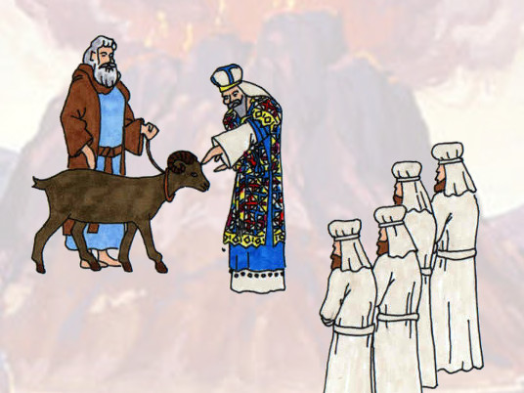
And thou shalt take the other ram;

Slide 42
and Aaron and his sons shall put their hands upon the head of the ram.

Slide 43
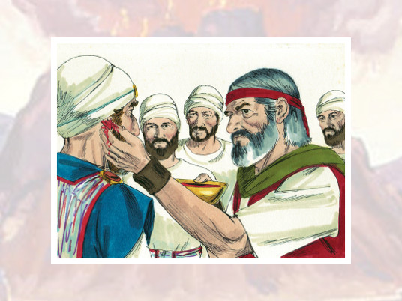
Then shalt thou kill the ram, and take of his blood,

Slide 44
and put it upon the tip of the right ear of Aaron, and upon the tip of the right ear of his sons,

Slide 45
and upon the thumb of their right hand, and upon the great toe of their right foot,

Slide 46
and sprinkle the blood upon the altar round about.

Slide 47
Responsive Reading:
Exodus 29:21 – 29:28
Notes:
<number>
<number>
<number>

Slide 48
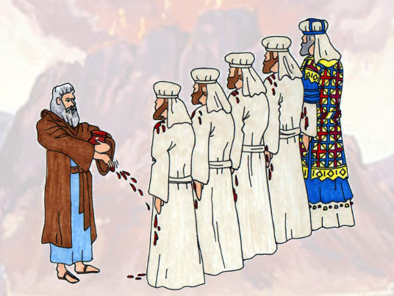
And thou shalt take of the blood that is upon the altar, and of the anointing oil,

Slide 49
and sprinkle it upon Aaron, and upon his garments, and upon his sons,

Slide 50
and upon the garments of his sons with him: and he shall be hallowed,

Slide 51
and his garments, and his sons, and his sons garments with him.

Slide 52
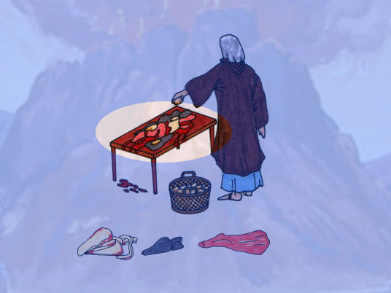
Also thou shalt take of the ram the fat and the rump, and the fat that covereth the inwards,

Slide 53
and the caul above the liver, and the two kidneys, and the fat that is upon them,

Slide 54
and the right shoulder; for it is a ram of consecration:

Slide 55
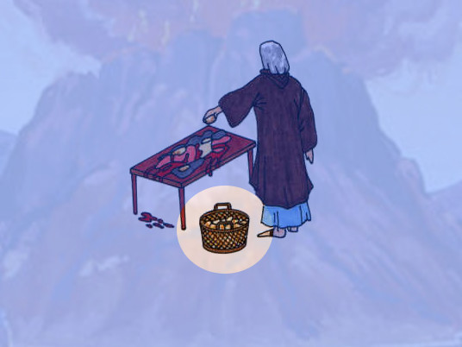
And one loaf of bread, and one cake of oiled bread,

Slide 56
and one wafer out of the basket of the unleavened bread that is before the LORD:

Slide 57
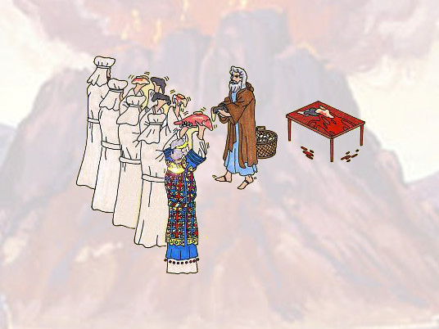
And thou shalt put all in the hands of Aaron, and in the hands of his sons;

Slide 58
and shalt wave them for a wave oﬀering before the LORD.

Slide 59
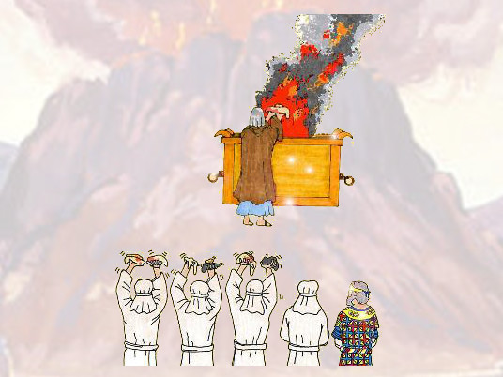
And thou shalt receive them of their hands, and burn them upon the altar for a burnt oﬀering,

Slide 60
for a sweet savour before the LORD: it is an oﬀering made by ﬁre unto the LORD.

Slide 61
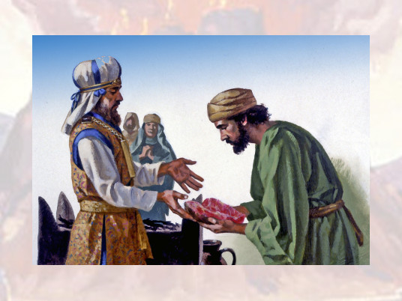
And thou shalt take the breast of the ram of Aarons consecration,

Slide 62
and wave it for a wave oﬀering before the LORD: and it shall be thy part.

Slide 63
And thou shalt sanctify the breast of the wave oﬀering,

Slide 64
and the shoulder of the heave oﬀering, which is waved,

Slide 65
and which is heaved up, of the ram of the consecration, even of that which is for Aaron,

Slide 66
and of that which is for his sons:

Slide 67
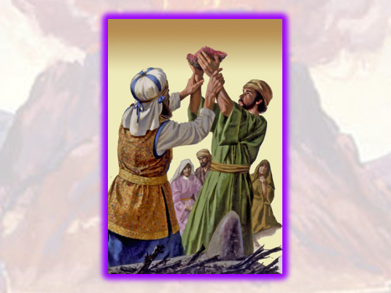
And it shall be Aarons and his sons by a statute for ever from the children of Israel:

Slide 68
for it is an heave oﬀering: and it shall be an heave oﬀering

Slide 69
from the children of Israel of the sacriﬁce of their peace oﬀerings,

Slide 70
even their heave oﬀering unto the LORD.

Slide 71
Responsive Reading:
Exodus 29:29 – 29:36
Notes:
<number>
<number>
<number>

Slide 72
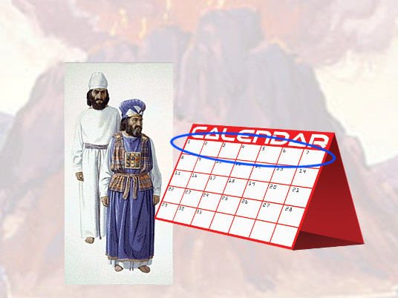
And the holy garments of Aaron shall be his sons after him,

Slide 73
to be anointed therein, and to be consecrated in them.

Slide 74
And that son that is priest in his stead shall put them on seven days,

Slide 75
when he cometh into the tabernacle of the congregation to minister in the holy place.

Slide 76
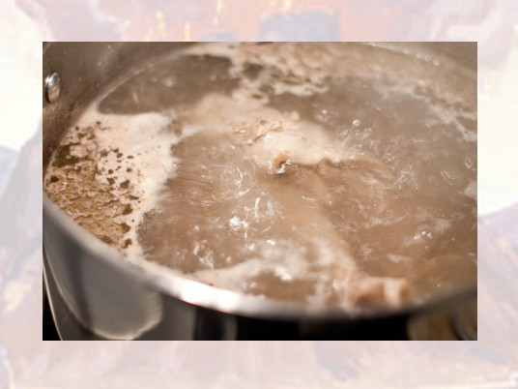
And thou shalt take the ram of the consecration, and seethe his ﬂesh in the holy place.

Slide 77
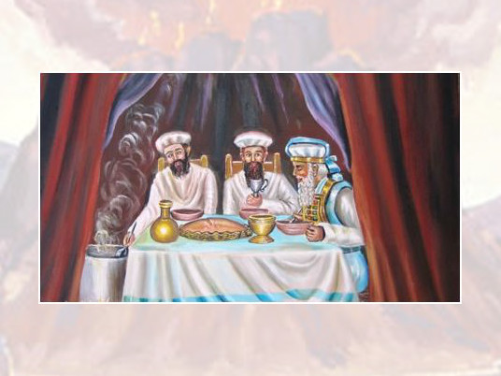
And Aaron and his sons shall eat the ﬂesh of the ram, and the bread that is in the basket,

Slide 78
by the door of the tabernacle of the congregation.

Slide 79
And they shall eat those things wherewith the atonement was made,

Slide 80
to consecrate and to sanctify them: but a stranger shall not eat thereof, because they are holy.

Slide 81
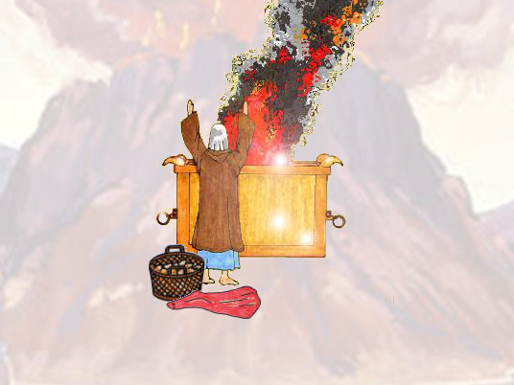
And if ought of the ﬂesh of the consecrations, or of the bread, remain unto the morning,

Slide 82
then thou shalt burn the remainder with ﬁre: it shall not be eaten, because it is holy.

Slide 83
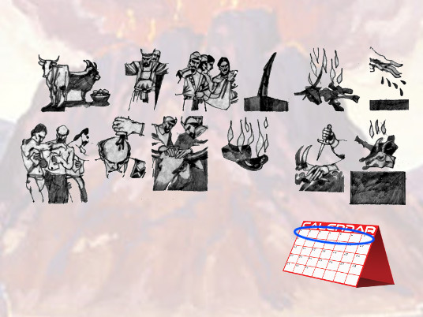
And thus shalt thou do unto Aaron, and to his sons,

Slide 84
according to all things which I have commanded thee:

Slide 85
seven days shalt thou consecrate them.

Slide 86
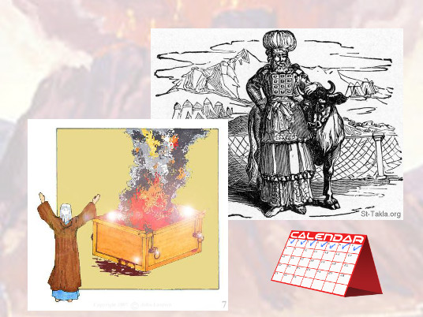
And thou shalt oﬀer every day a bullock for a sin oﬀering for atonement:

Slide 87
and thou shalt cleanse the altar, when thou hast made an atonement for it,

Slide 88
and thou shalt anoint it, to sanctify it.

Slide 89
Responsive Reading:
Exodus 29:37 – 29:44
Notes:
<number>
<number>
<number>

Slide 90
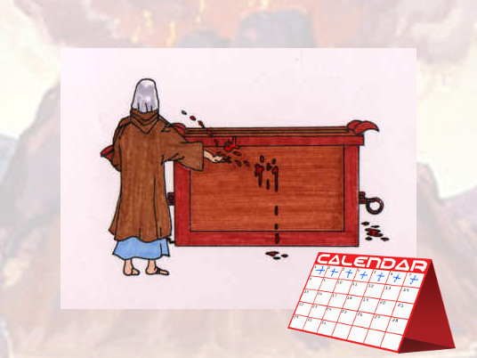
Seven days thou shalt make an atonement for the altar, and sanctify it;

Slide 91
and it shall be an altar most holy: whatsoever toucheth the altar shall be holy.

Slide 92
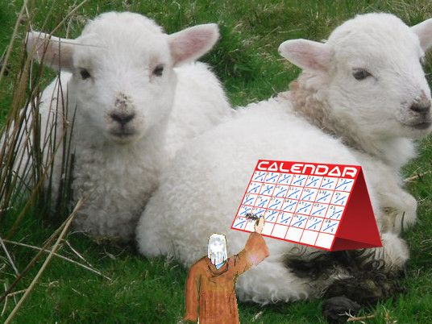
Now this is that which thou shalt oﬀer upon the altar;

Slide 93
two lambs of the ﬁrst year day by day continually.

Slide 94
The one lamb thou shalt oﬀer in the morning; and the other lamb thou shalt oﬀer at even:

Slide 95
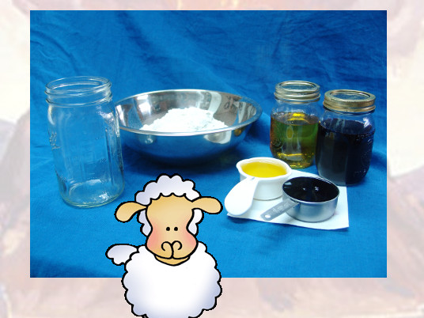
And with the one lamb a tenth deal of ﬂour mingled with the fourth part of an hin of beaten oil;

Slide 96
and the fourth part of an hin of wine for a drink oﬀering.

Slide 97
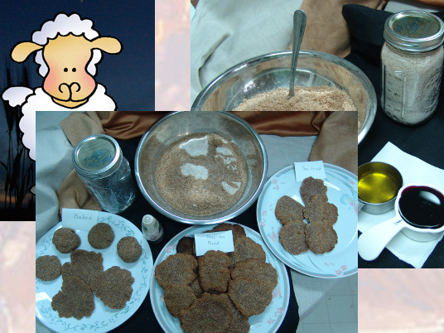
And the other lamb thou shalt oﬀer at even,

Slide 98
and shalt do thereto according to the meat oﬀering of the morning,

Slide 99
and according to the drink oﬀering thereof, for a sweet savour,

Slide 100
an oﬀering made by ﬁre unto the LORD.

Slide 101
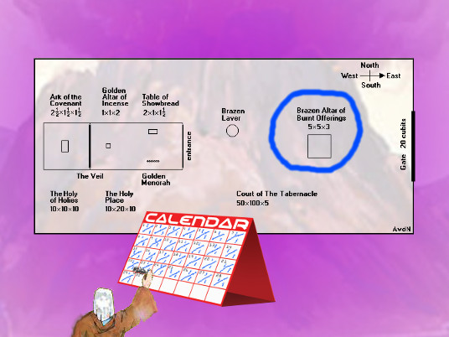
This shall be a continual burnt oﬀering throughout your generations

Slide 102
at the door of the tabernacle of the congregation before the LORD:

Slide 103
where I will meet you, to speak there unto thee.

Slide 104
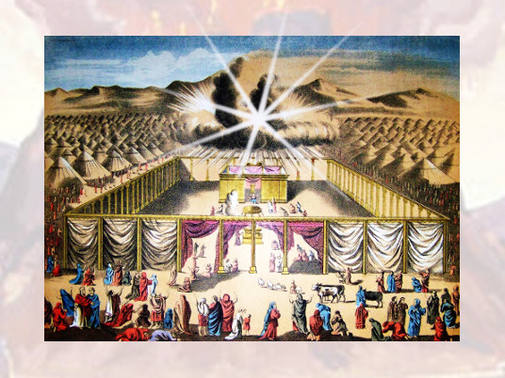
And there I will meet with the children of Israel,

Slide 105
and the tabernacle shall be sanctiﬁed by my glory.

Slide 106
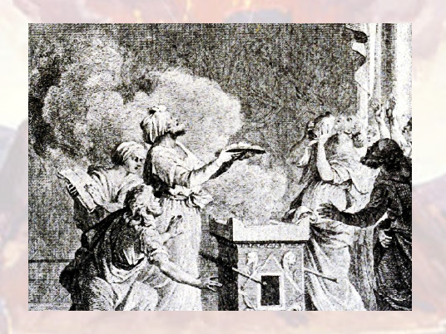
And I will sanctify the tabernacle of the congregation, and the altar:

Slide 107
I will sanctify also both Aaron and his sons, to minister to me in the priests oﬃce

Slide 108
Responsive Reading:
Exodus 29:45 – 39:46
Notes:
<number>
<number>
<number>

Slide 109
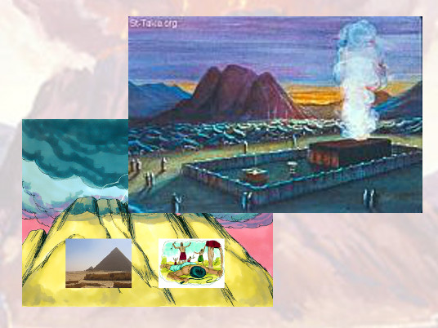
⁴⁵And I will dwell among the children of Israel, and will be their God.

Slide 110
⁴⁶And they shall know that I am the LORD their God, that brought them forth out of the land of Egypt,

Slide 111
that I may dwell among them: I am the LORD their God.

