Slide 1
Responsive Reading:
Exodus 32:1 – 32:6
Notes:
<number>
<number>
<number>

Slide 2
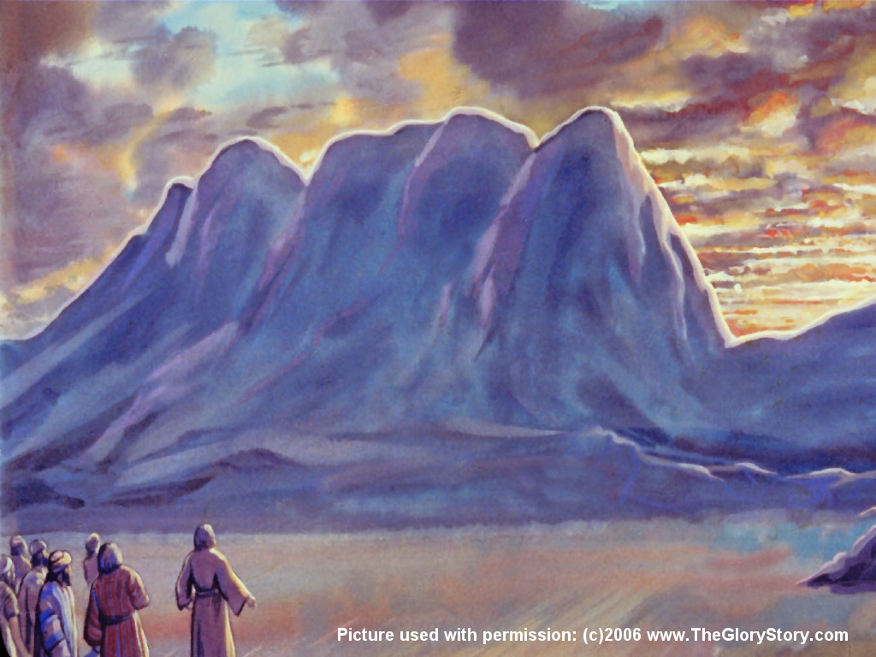
And when the people saw that Moses delayed to come down out of the mount,

Slide 3
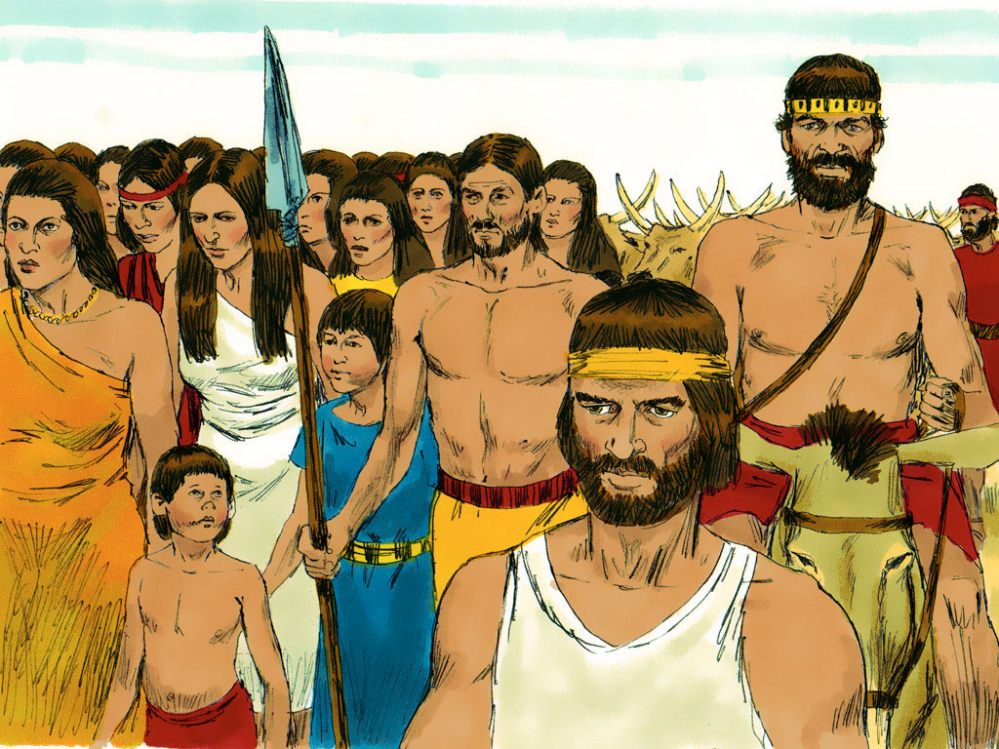
the people gathered themselves together unto Aaron, and said unto him,

Slide 4
Up, make us gods, which shall go before us; for as for this Moses,

Slide 5
the man that brought us up out of the land of Egypt, we wot not what is become of him.

Slide 6
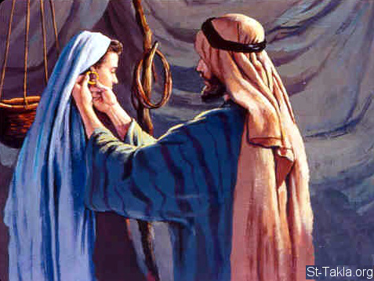
And Aaron said unto them, Break oﬀ the golden earrings,

Slide 7
which are in the ears of your wives, of your sons, and of your daughters,

Slide 8
and bring them unto me.

Slide 9
And all the people brake oﬀ the golden earrings which were in their ears,

Slide 10
and brought them unto Aaron.

Slide 11
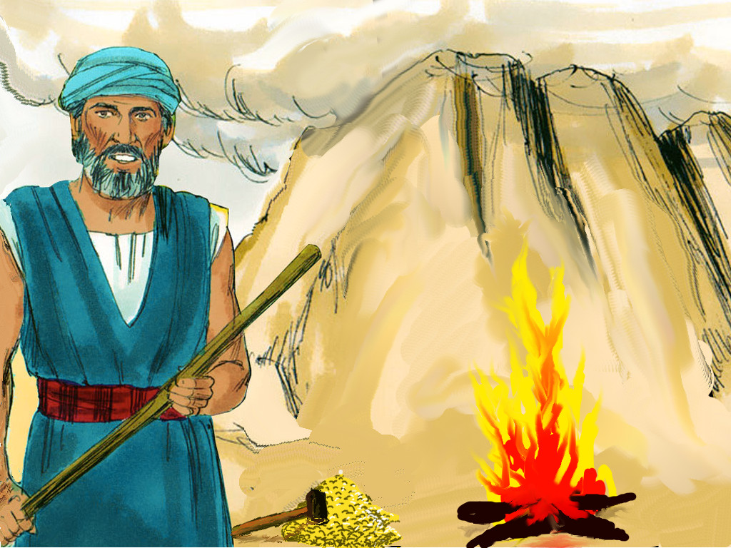
And he received them at their hand, and fashioned it with a graving tool,

Slide 12
after he had made it a molten calf: and they said,

Slide 13
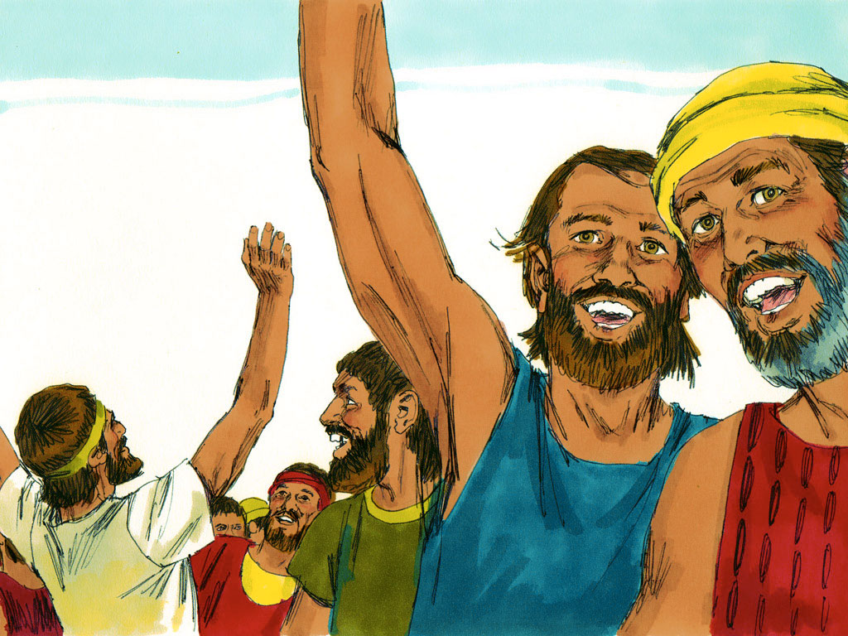
These be thy gods, O Israel, which brought thee up out of the land of Egypt

Slide 14
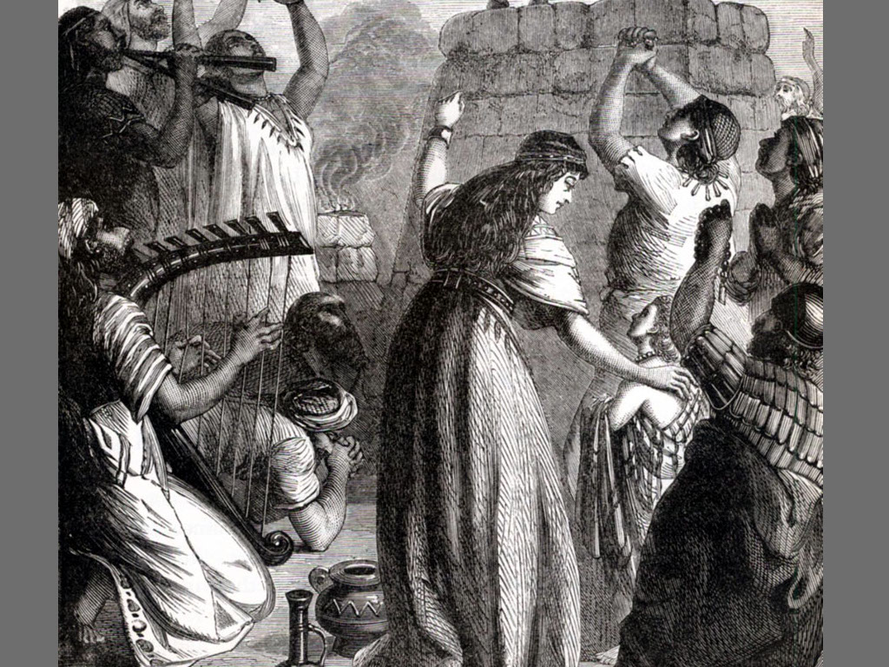
And when Aaron saw it, he built an altar before it; and Aaron made proclamation,

Slide 15
and said, To morrow is a feast to the LORD.

Slide 16
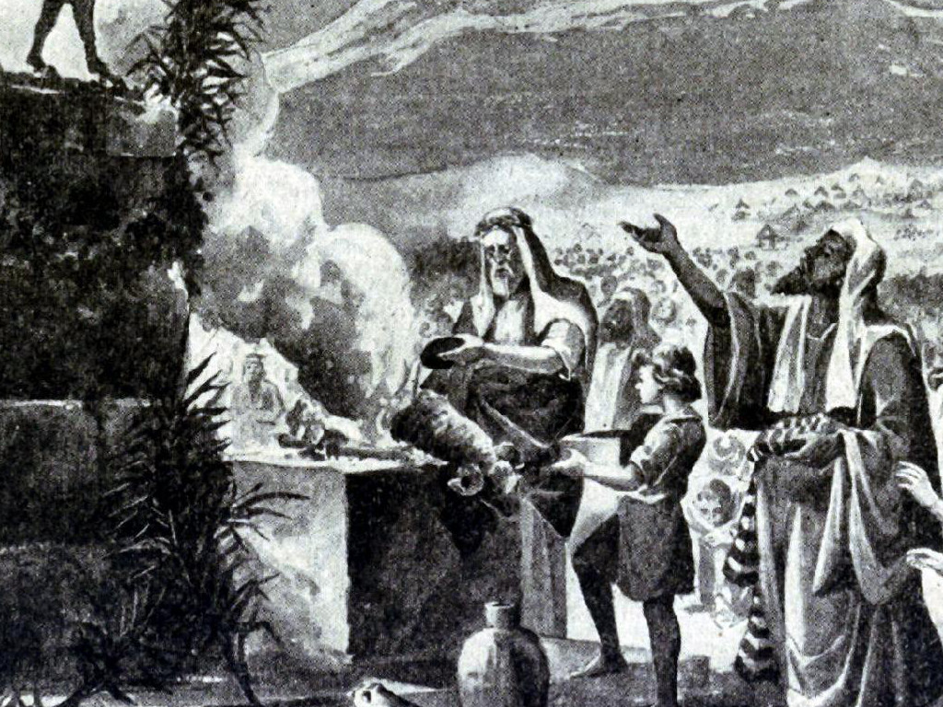
And they rose up early on the morrow, and oﬀered burnt oﬀerings, and brought peace oﬀerings;

Slide 17
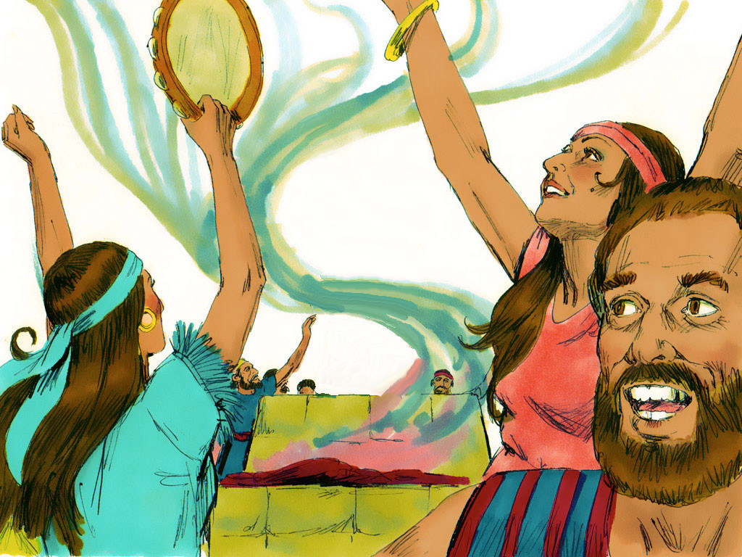
and the people sat down to eat and to drink, and rose up to play

Slide 18
Responsive Reading:
Exodus 32:7 – 32:14
Notes:
<number>
<number>
<number>

Slide 19
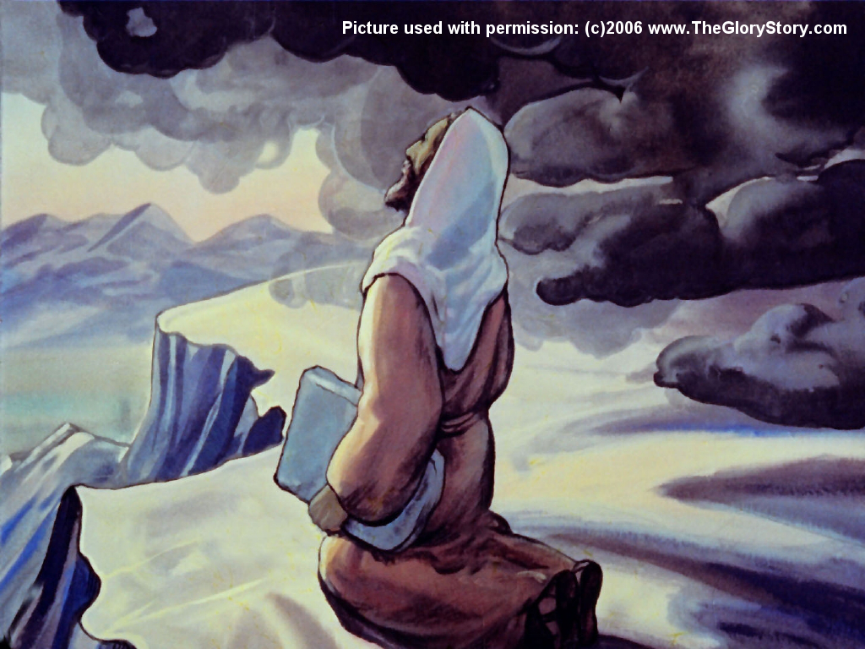
And the LORD said unto Moses, Go, get thee down;

Slide 20
for thy people, which thou broughtest out of the land of Egypt, have corrupted themselves:

Slide 21
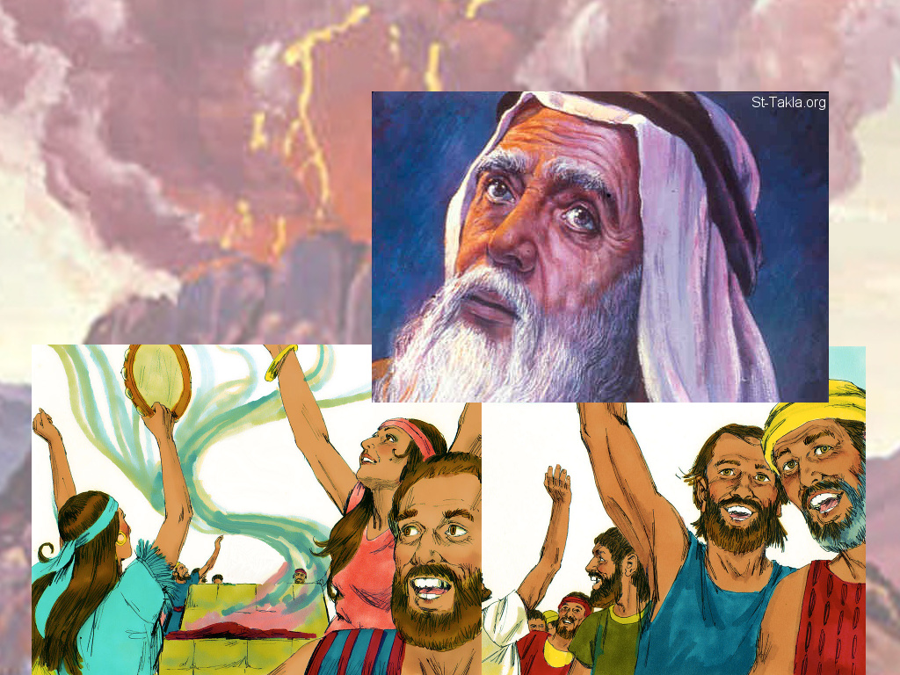
They have turned aside quickly out of the way which I commanded them:

Slide 22
they have made them a molten calf, and have worshipped it,

Slide 23
and have sacriﬁced thereunto, and said, These be thy gods, O Israel,

Slide 24
which have brought thee up out of the land of Egypt.

Slide 25
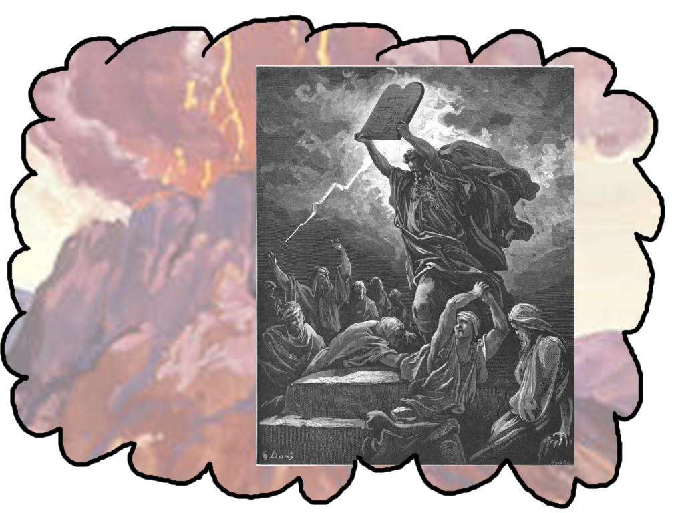
And the LORD said unto Moses, I have seen this people,

Slide 26
and, behold, it is a stiﬀnecked people:

Slide 27
Now therefore let me alone, that my wrath may wax hot against them,

Slide 28
and that I may consume them: and I will make of thee a great nation.

Slide 29
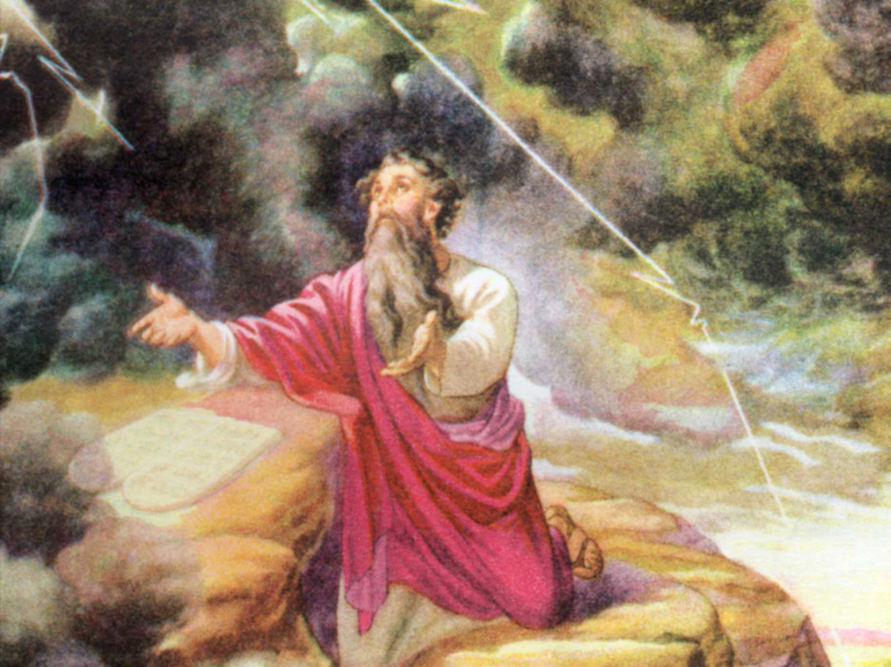
And Moses besought the LORD his God, and said,

Slide 30
LORD, why doth thy wrath wax hot against thy people,

Slide 31
which thou hast brought forth out of the land of Egypt with great power,

Slide 32
and with a mighty hand?

Slide 33
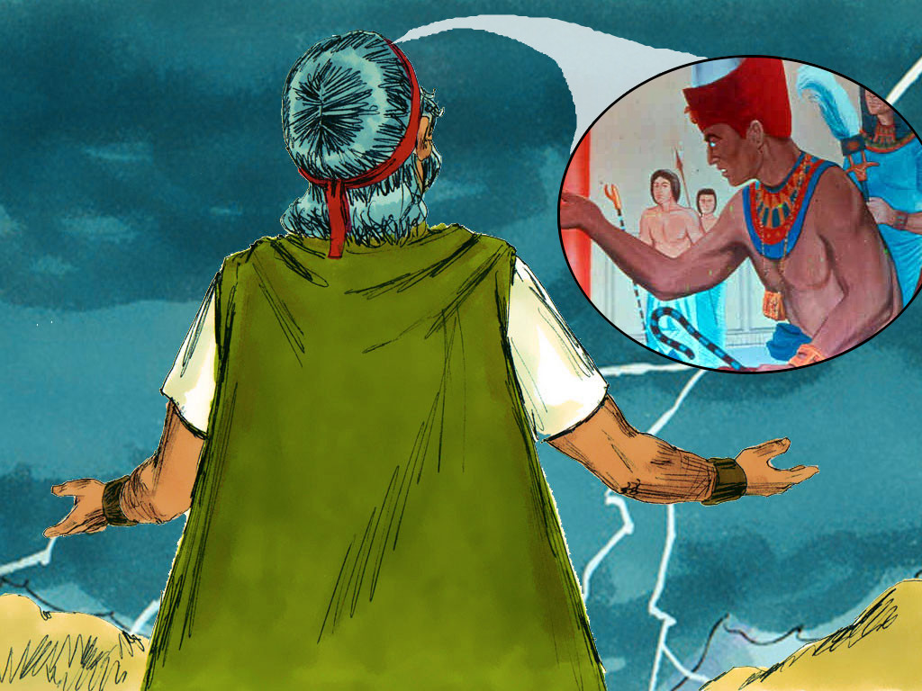
Wherefore should the Egyptians speak, and say,

Slide 34
For mischief did he bring them out, to slay them in the mountains,

Slide 35
and to consume them from the face of the earth?

Slide 36
Turn from thy ﬁerce wrath, and repent of this evil against thy people.

Slide 37
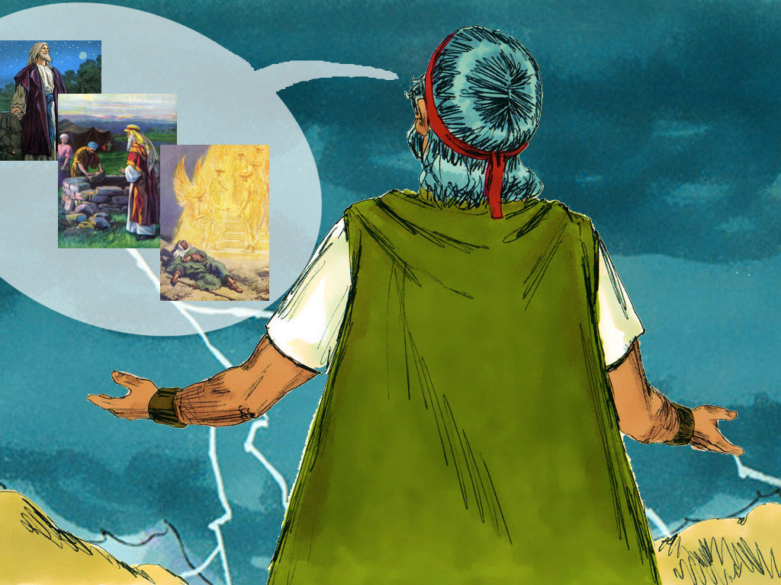
Remember Abraham, Isaac, and Israel, thy servants,

Slide 38
to whom thou swarest by thine own self, and saidst unto them,

Slide 39
I will multiply your seed as the stars of heaven,

Slide 40
and all this land that I have spoken of will I give unto your seed,

Slide 41
and they shall inherit it for ever.

Slide 42
And the LORD repented of the evil which he thought to do unto his people.

Slide 43
Responsive Reading:
Exodus 32:15 – 32:22
Notes:
<number>
<number>
<number>

Slide 44
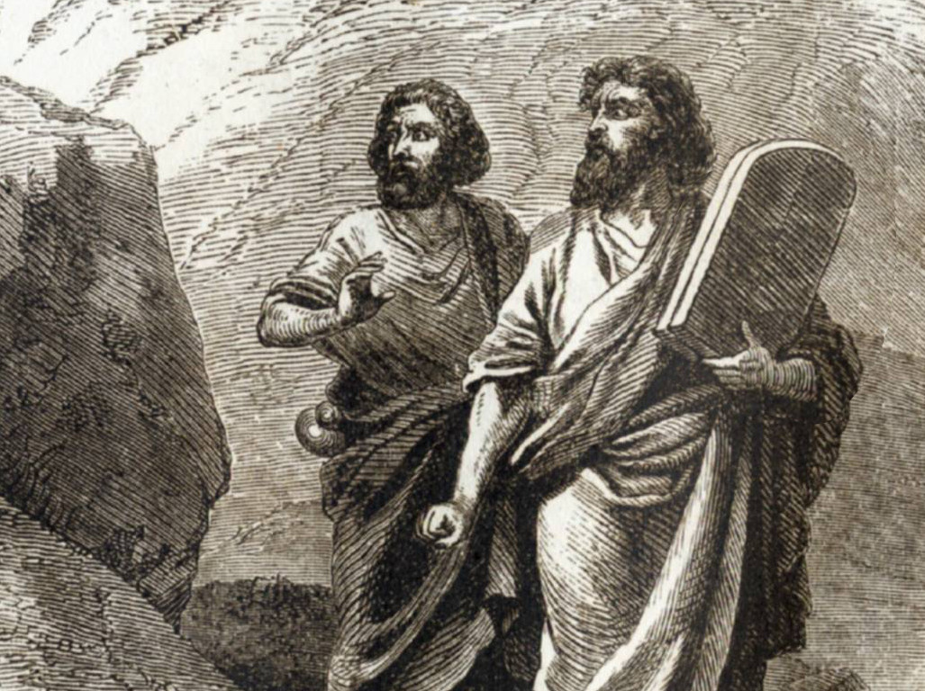
And Moses turned, and went down from the mount,

Slide 45
and the two tables of the testimony were in his hand:

Slide 46
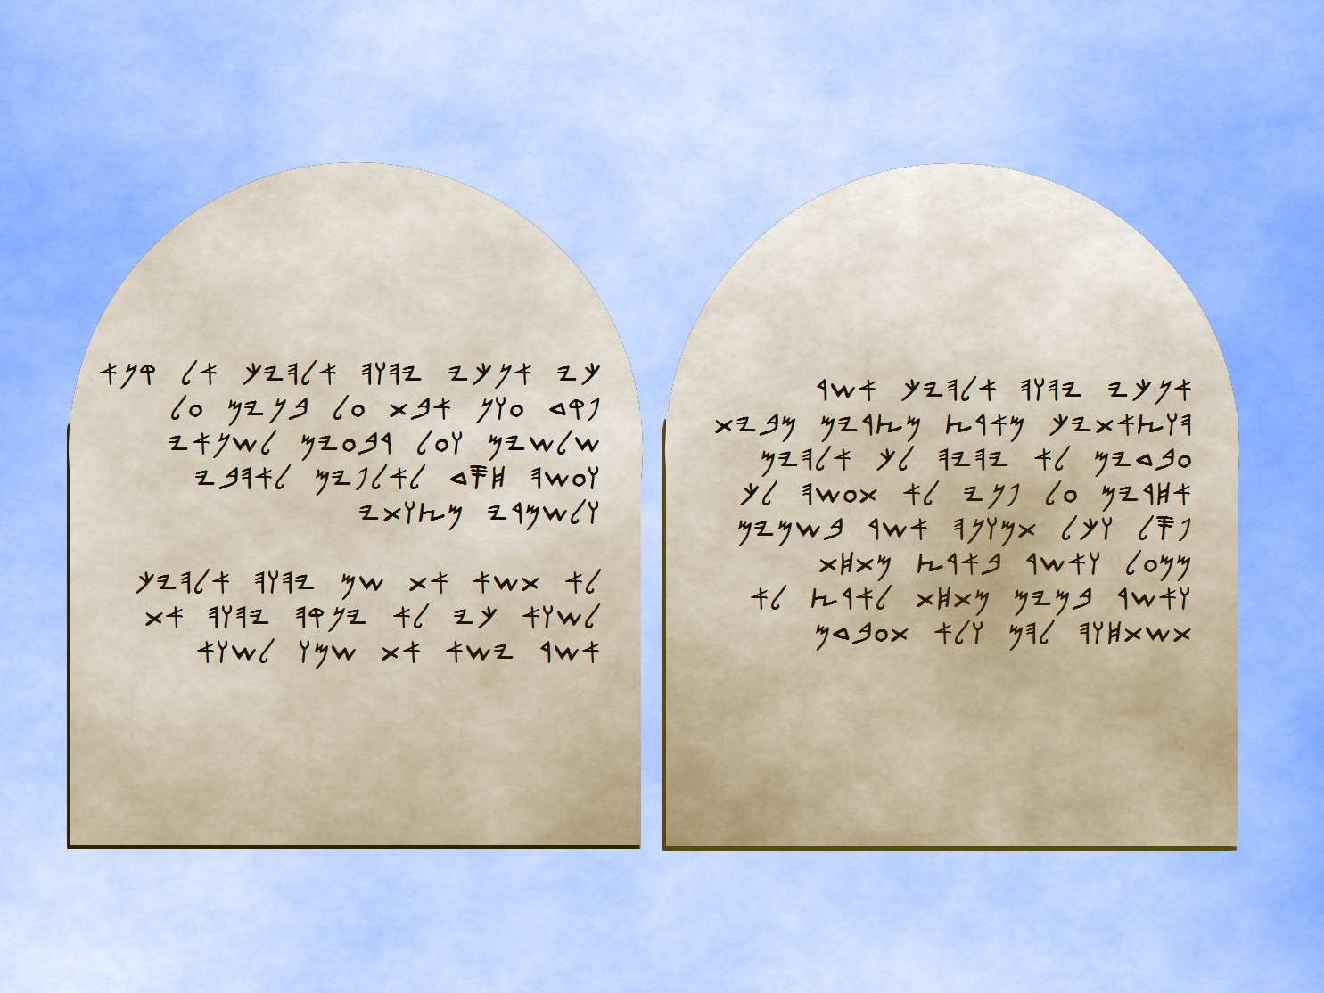
the tables were written on both their sides; on the one side and

Slide 47
on the other were they written

Slide 48
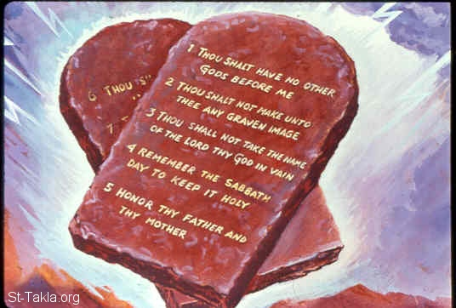
And the tables were the work of God, and the writing was the writing of God, graven upon the tables.

Slide 49
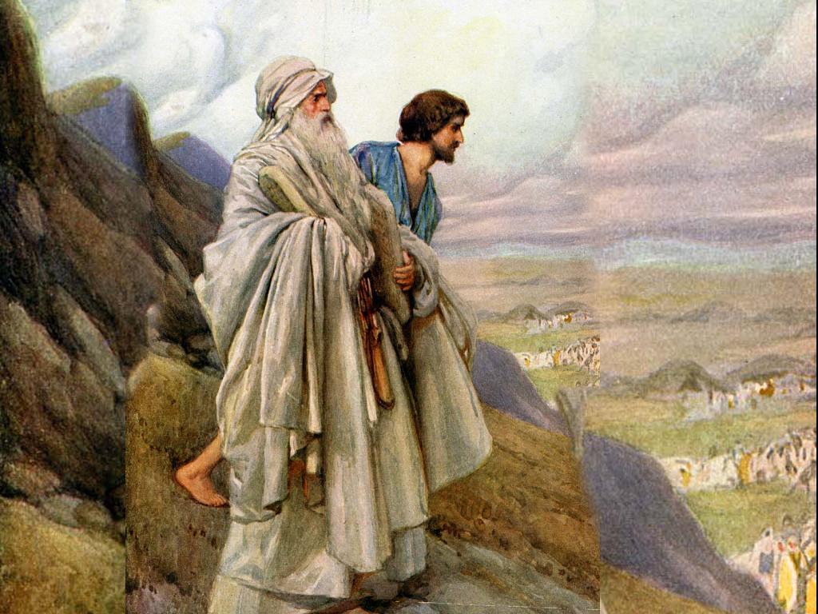
And when Joshua heard the noise of the people as they shouted, he said unto Moses,

Slide 50
There is a noise of war in the camp.

Slide 51
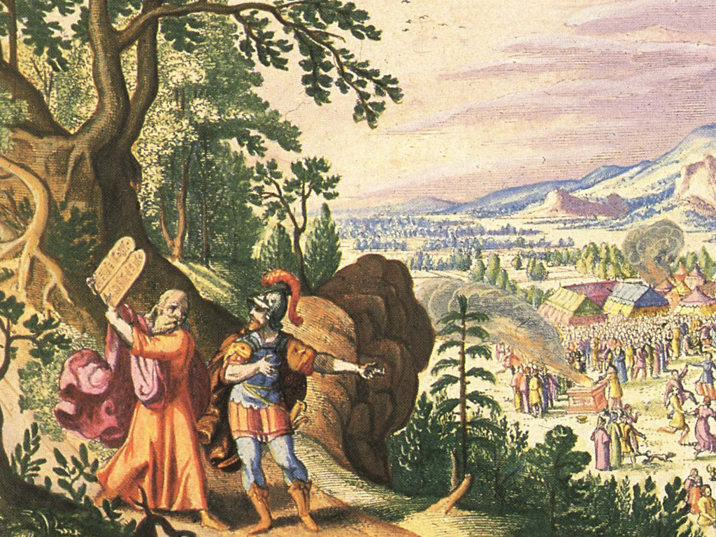
And he said, It is not the voice of them that shout for mastery,

Slide 52
neither is it the voice of them that cry for being overcome:

Slide 53
but the noise of them that sing do I hear.

Slide 54
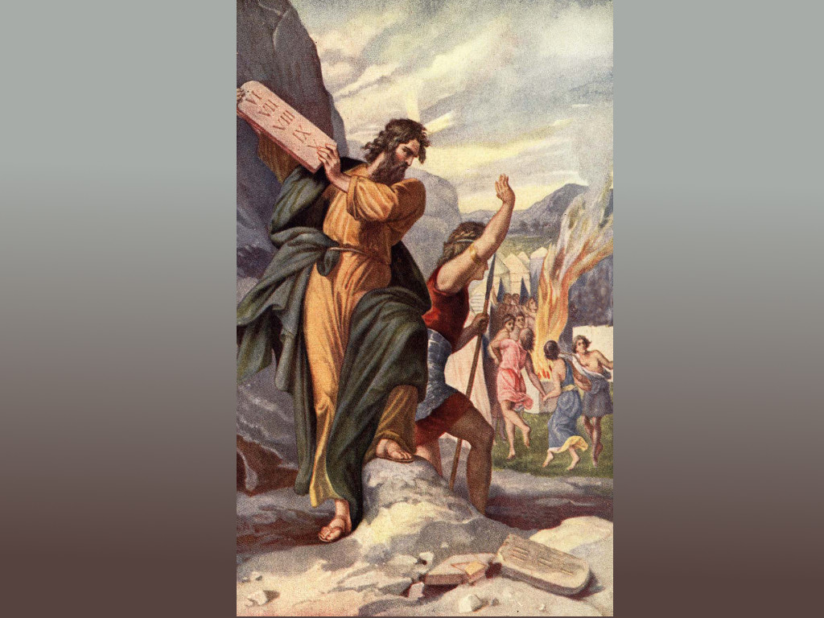
And it came to pass, as soon as he came nigh unto the camp, that he saw the calf,

Slide 55
and the dancing: and Moses anger waxed hot, and he cast the tables out of his hands,

Slide 56
and brake them beneath the mount.

Slide 57
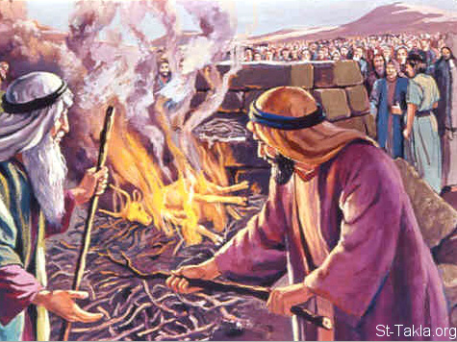
And he took the calf which they had made, and burnt it in the ﬁre,

Slide 58
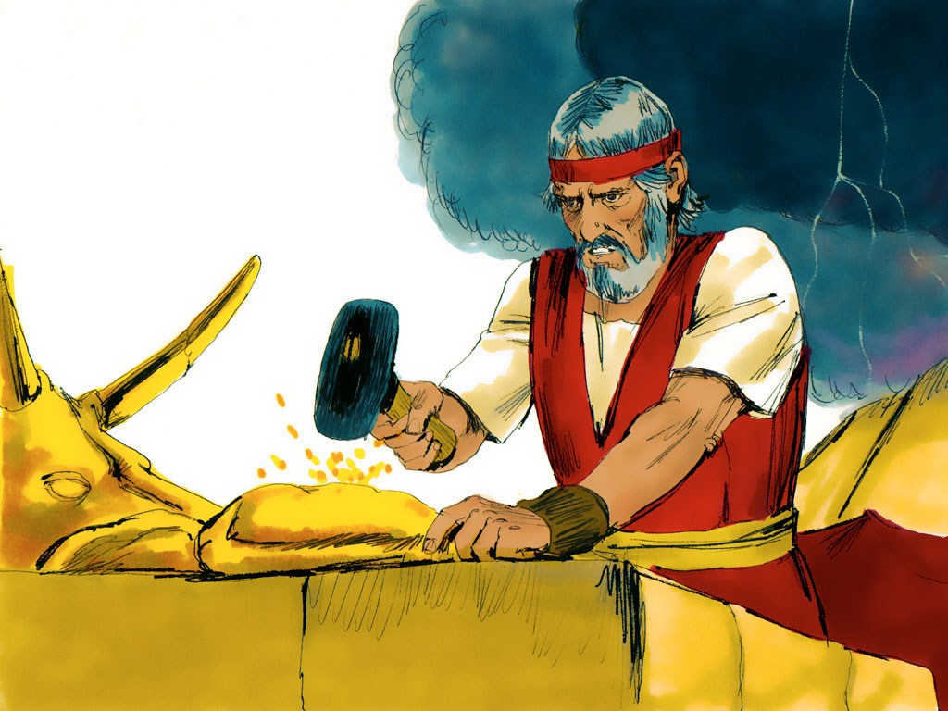
and ground it to powder, and strawed it upon the water,

Slide 59
and made the children of Israel drink of it.

Slide 60
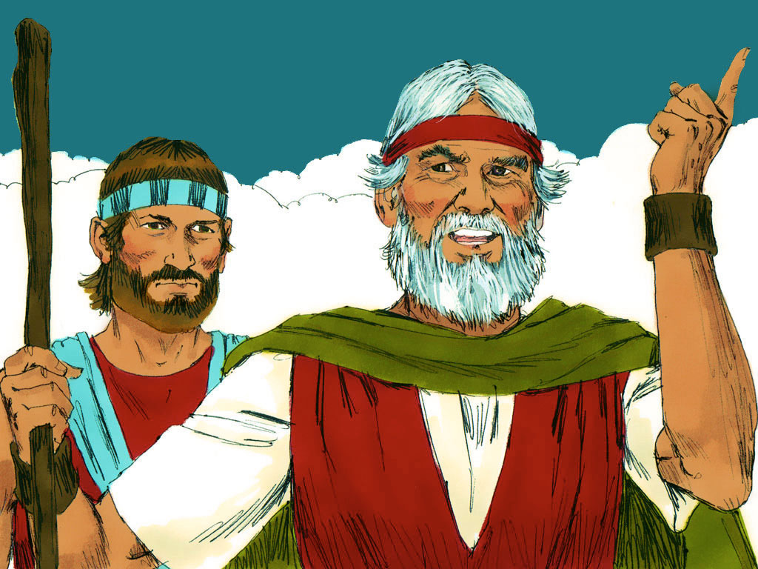
And Moses said unto Aaron, What did this people unto thee,

Slide 61
that thou hast brought so great a sin upon them?

Slide 62
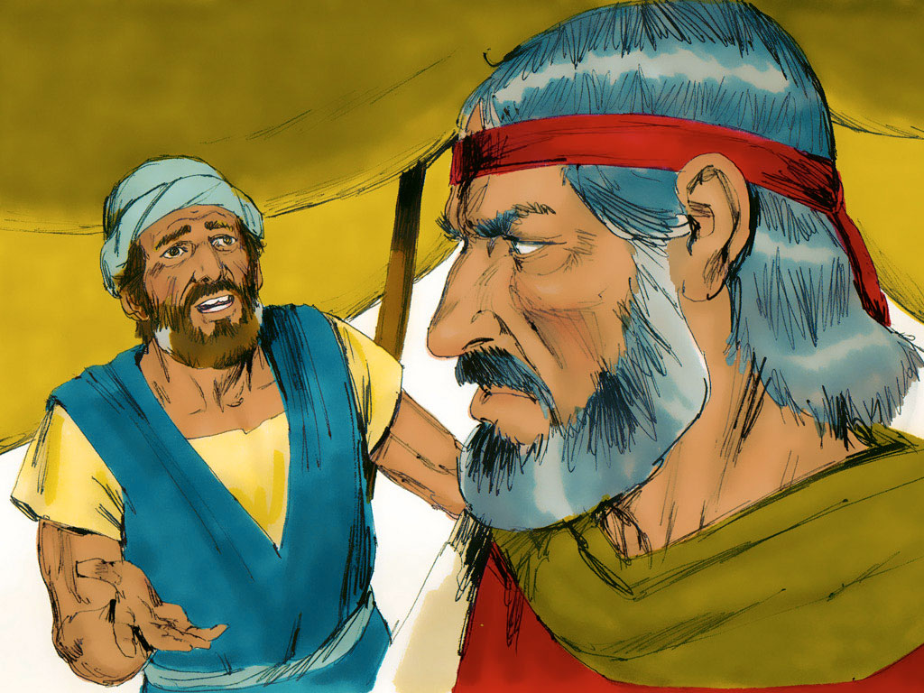
And Aaron said, Let not the anger of my lord wax hot: thou knowest the people,

Slide 63
that they are set on mischief.

Slide 64
Responsive Reading:
Exodus 32:23 – 32:30
Notes:
<number>
<number>
<number>

Slide 65
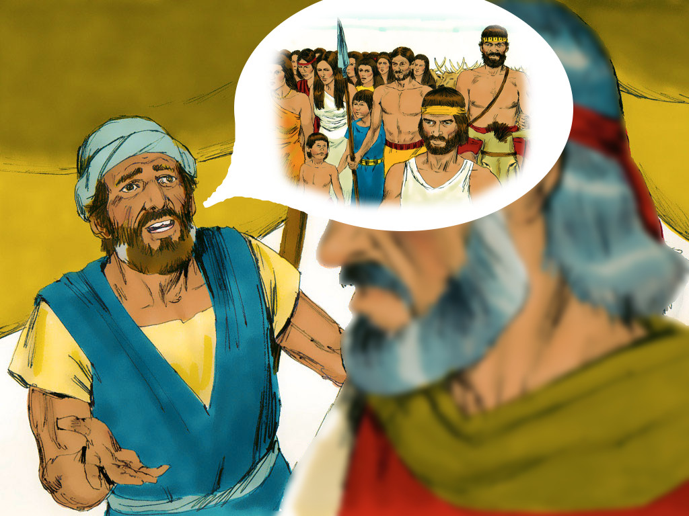
For they said unto me, Make us gods, which shall go before us:

Slide 66
for as for this Moses, the man that brought us up out of the land of Egypt,

Slide 67
we wot not what is become of him.

Slide 68
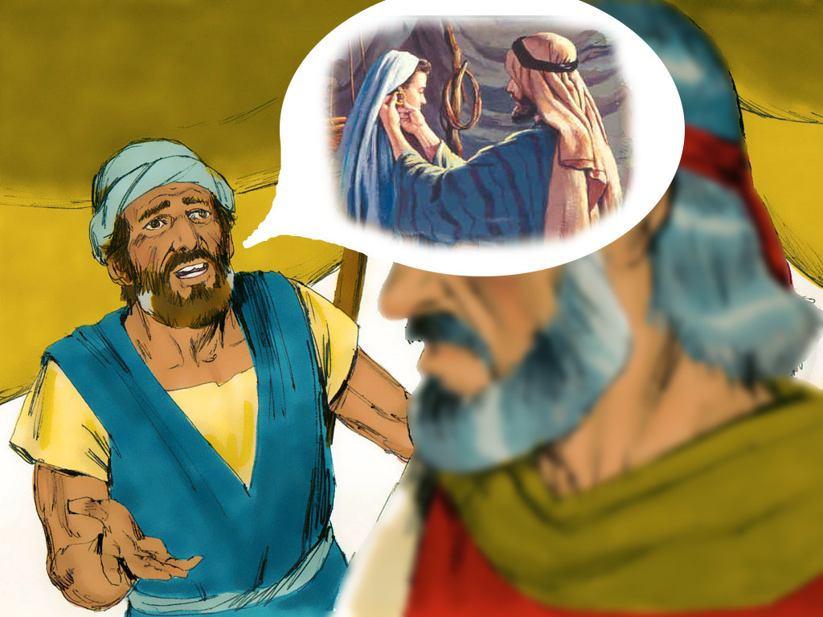
And I said unto them, Whosoever hath any gold, let them break it oﬀ. So they gave it me:

Slide 69
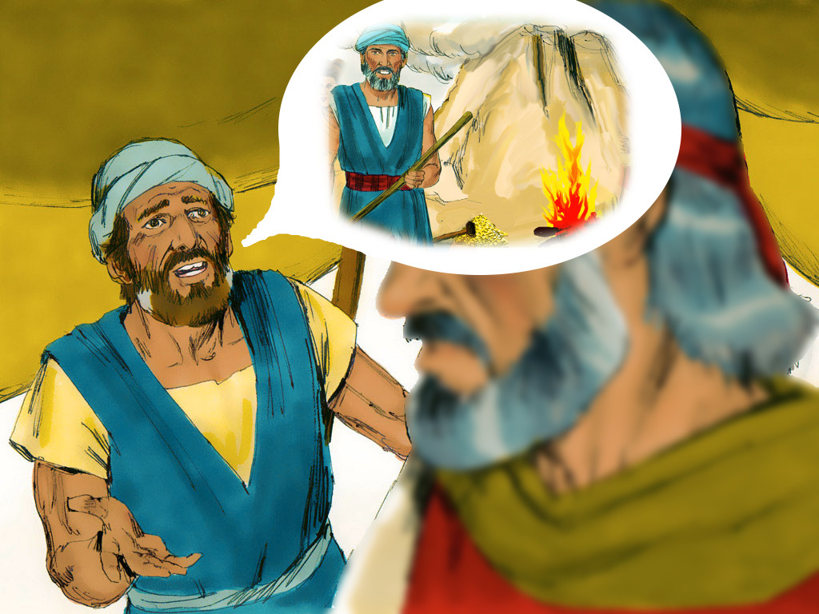
then I cast it into the ﬁre, and there came out this calf.

Slide 70
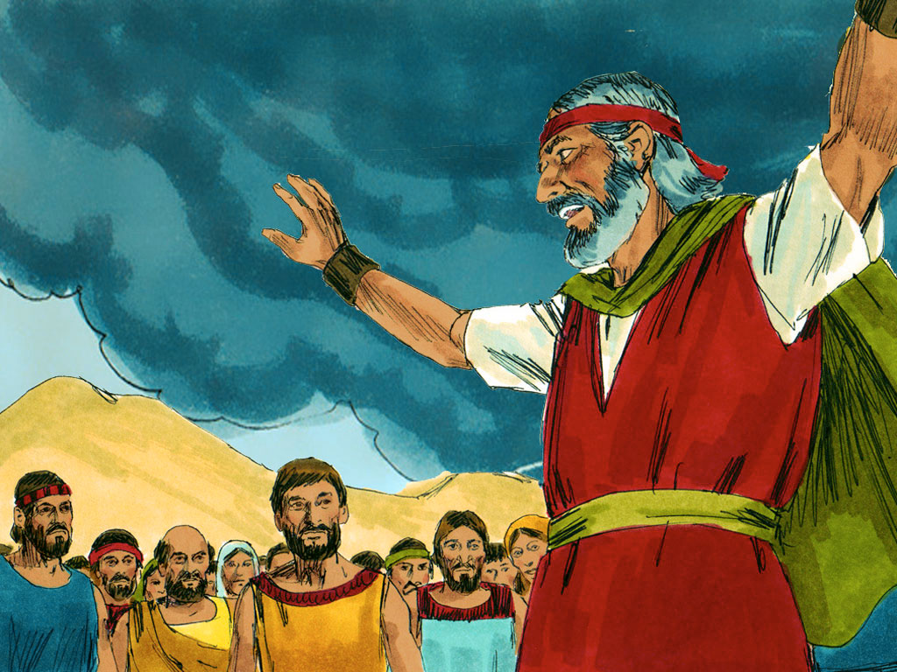
And when Moses saw that the people were naked;

Slide 71
(for Aaron had made them naked unto their shame among their enemies:)

Slide 72
Then Moses stood in the gate of the camp, and said, Who is on the LORDS side?

Slide 73
let him come unto me.

Slide 74
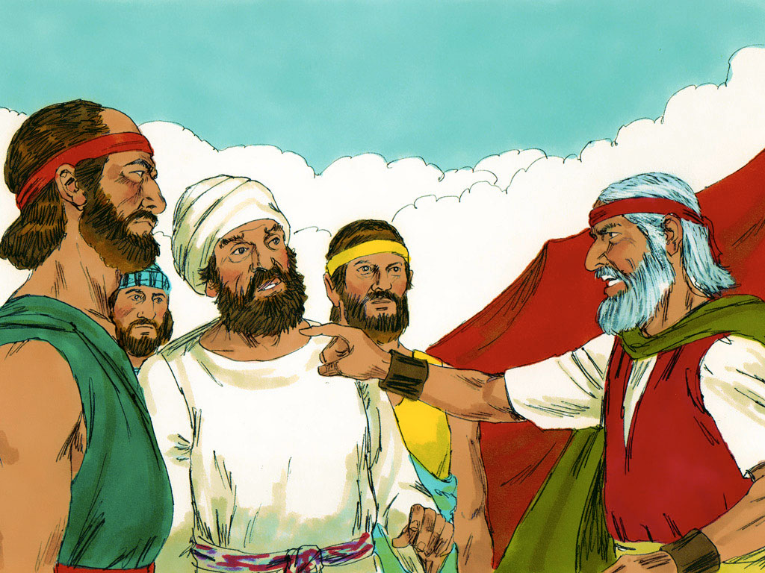
And all the sons of Levi gathered themselves together unto him

Slide 75
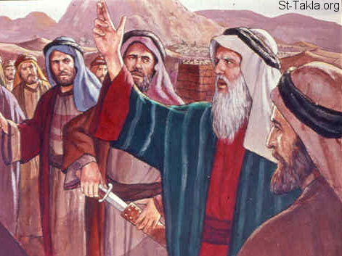
And he said unto them, Thus saith the LORD God of Israel,

Slide 76
Put every man his sword by his side,

Slide 77
and go in and out from gate to gate throughout the camp, and slay every man his brother,

Slide 78
and every man his companion, and every man his neighbour.

Slide 79
And the children of Levi did according to the word of Moses:

Slide 80
and there fell of the people that day about three thousand men.

Slide 81
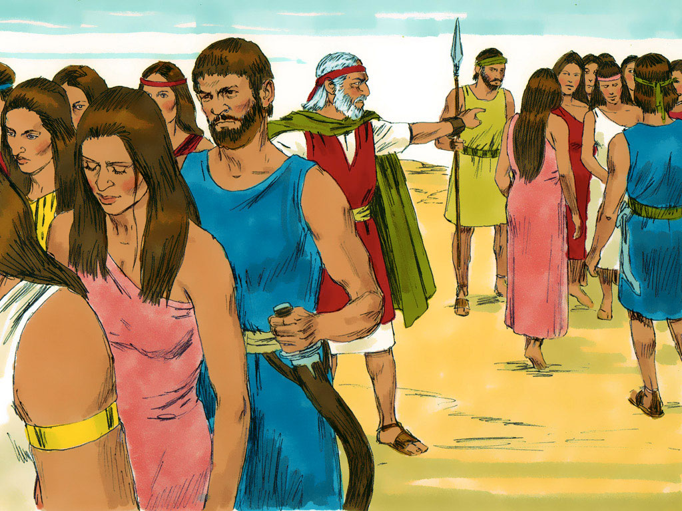
For Moses had said, Consecrate yourselves to day to the LORD,

Slide 82
even every man upon his son, and upon his brother;

Slide 83
that he may bestow upon you a blessing this day.

Slide 84
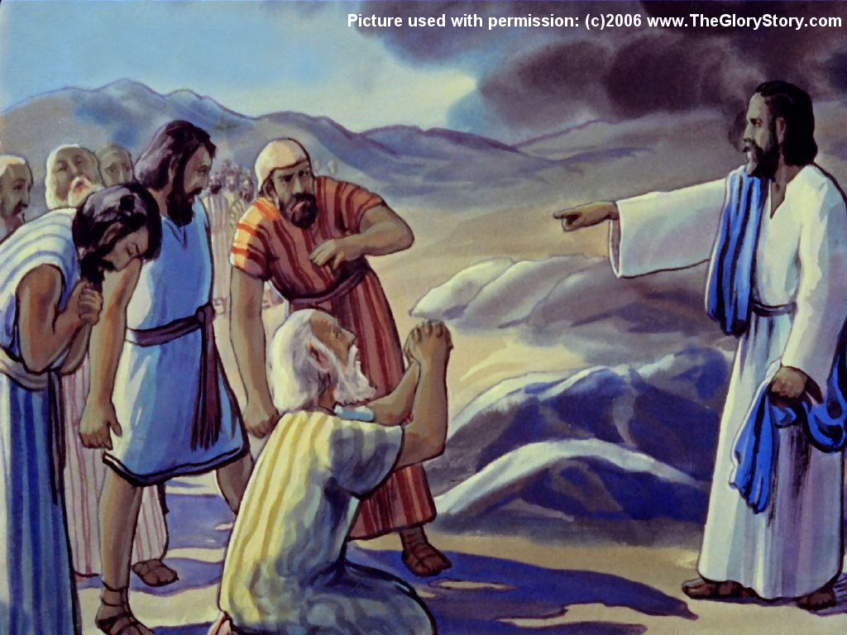
And it came to pass on the morrow, that Moses said unto the people,

Slide 85
Ye have sinned a great sin: and now I will go up unto the LORD;

Slide 86
peradventure I shall make an atonement for your sin.

Slide 87
Responsive Reading:
Exodus 32:31 – 32:35
Notes:
<number>
<number>
<number>

Slide 88
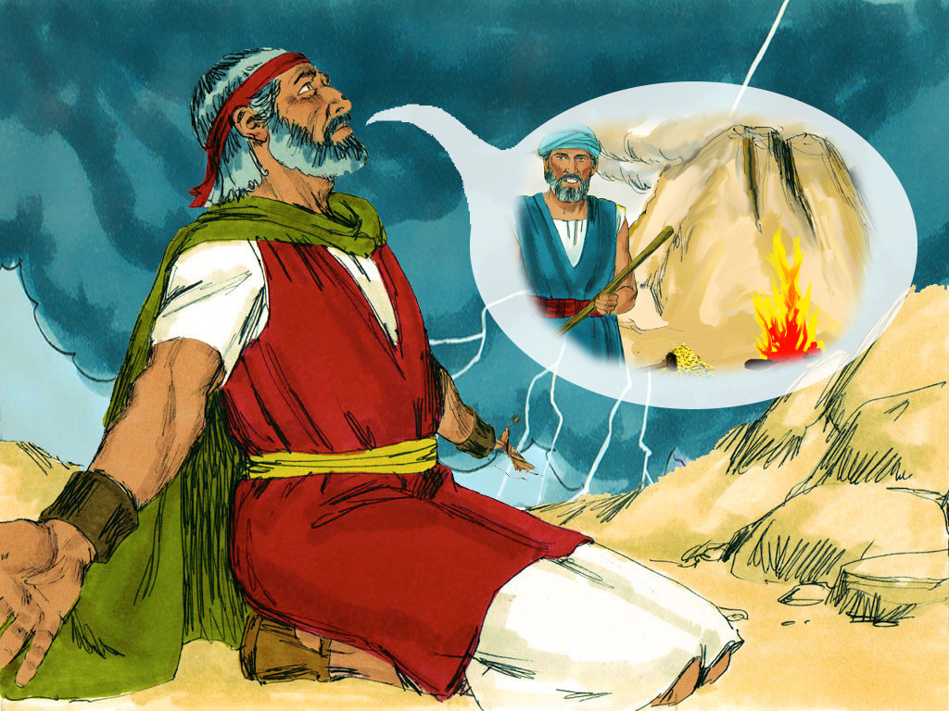
And Moses returned unto the LORD, and said, Oh, this people have sinned a great sin,

Slide 89
and have made them gods of gold

Slide 90
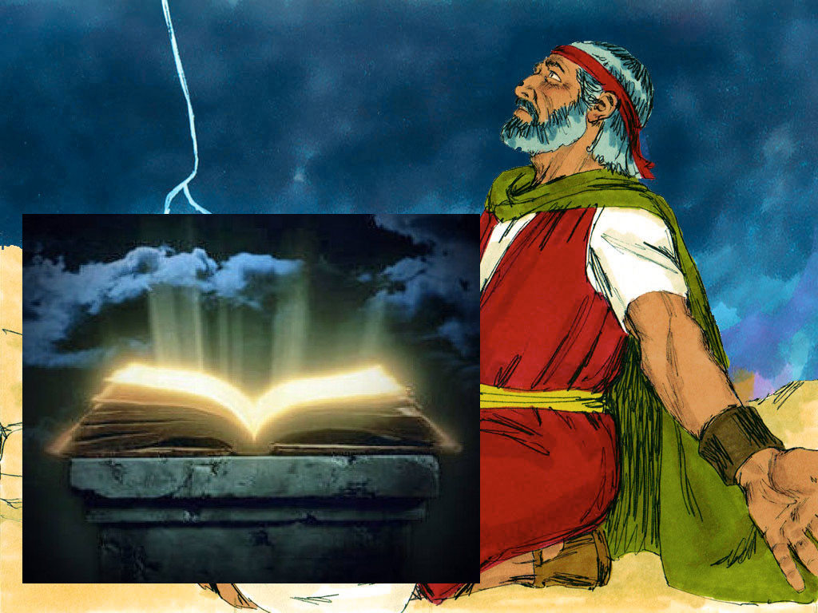
Yet now, if thou wilt forgive their sin; and if not, blot me, I pray thee,

Slide 91
out of thy book which thou hast written.

Slide 92
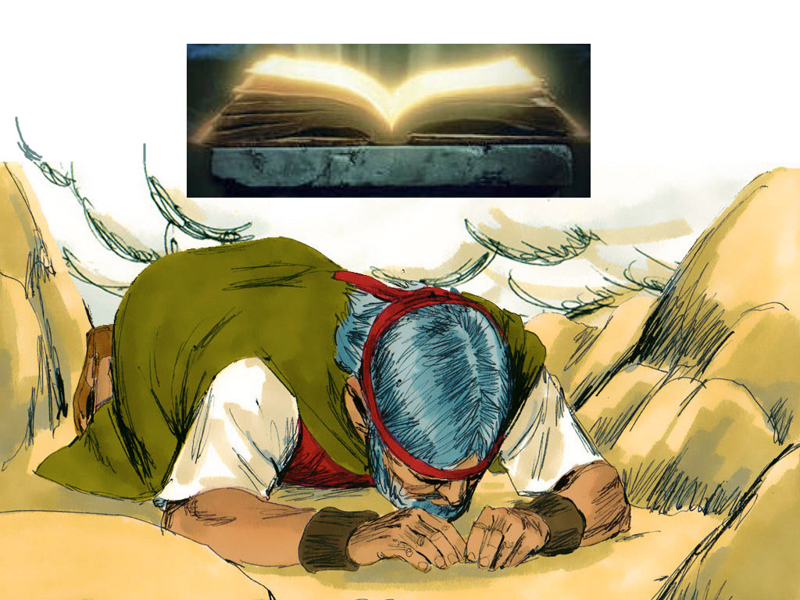
And the LORD said unto Moses,

Slide 93
Whosoever hath sinned against me, him will I blot out of my book.

Slide 94
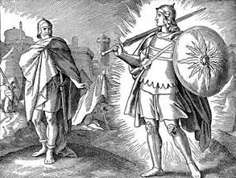
Therefore now go, lead the people unto the place of which I have spoken unto thee:

Slide 95
behold, mine Angel shall go before thee:

Slide 96
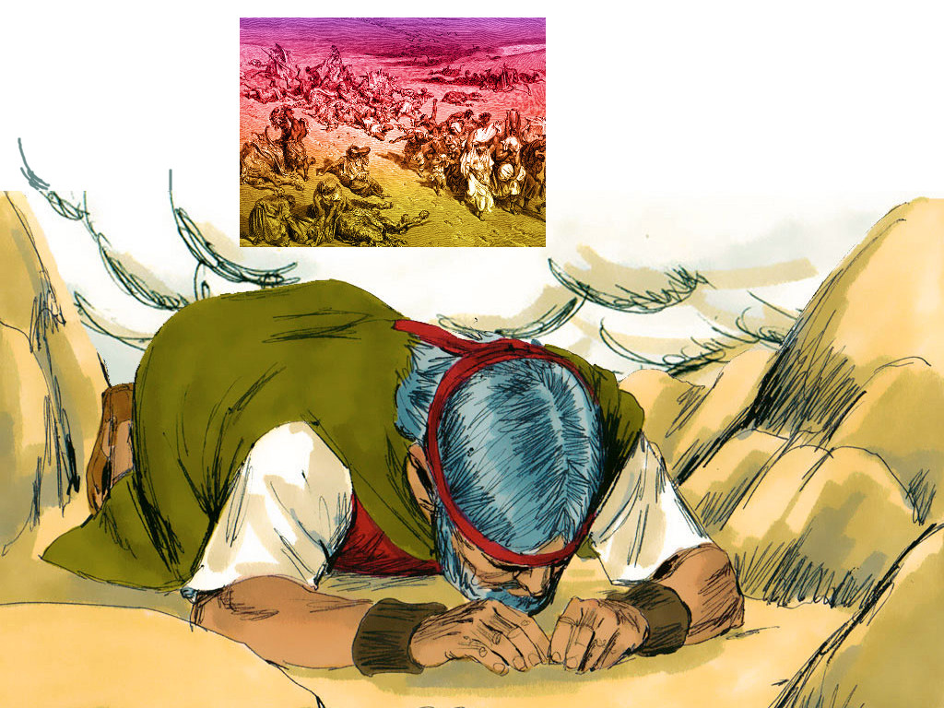
nevertheless in the day when I visit I will visit their sin upon them

Slide 97
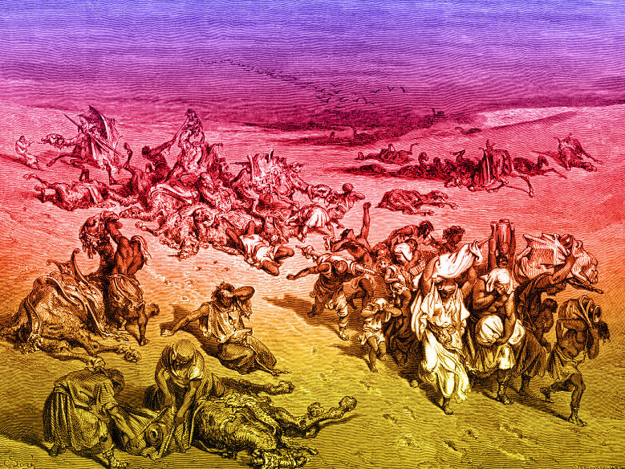
And the LORD plagued the people, because they made the calf, which Aaron made.

